Slide 1


The AI-driven Operations & Maintenance Platform for Real Estate Portfolios

Slide 2


Meet Facilio
The property operations cloud platform that allows owners & operators to aggregate building data, optimize performance & control portfolio operations – all from one place.
Powered by AI & IoT + deep industry expertise

Slide 3











The Problem
Multiple, incompatible systems lead to suboptimal operating margins
Disparate automation systems & equipment
Multiple point solutions & workflows
Energy Mgmt
Space &
Lease
Asset &
Inventory
HVAC
Fire Safety
Access
Lighting
Other Systems
Tenant
Engagement
Maintenance
Mgmt
Air Quality
Water Systems
Power
Control
Elevator
Limited access to access to real-time building data
Restricted flexibility on account of vendor lock-in
Inability to control dispersed portfolio
Arduous to manage
High dependence on vendor for scale or customization
Expensive; minimal value to all stakeholders
Inefficient Operations and Compressed Margins

Slide 4
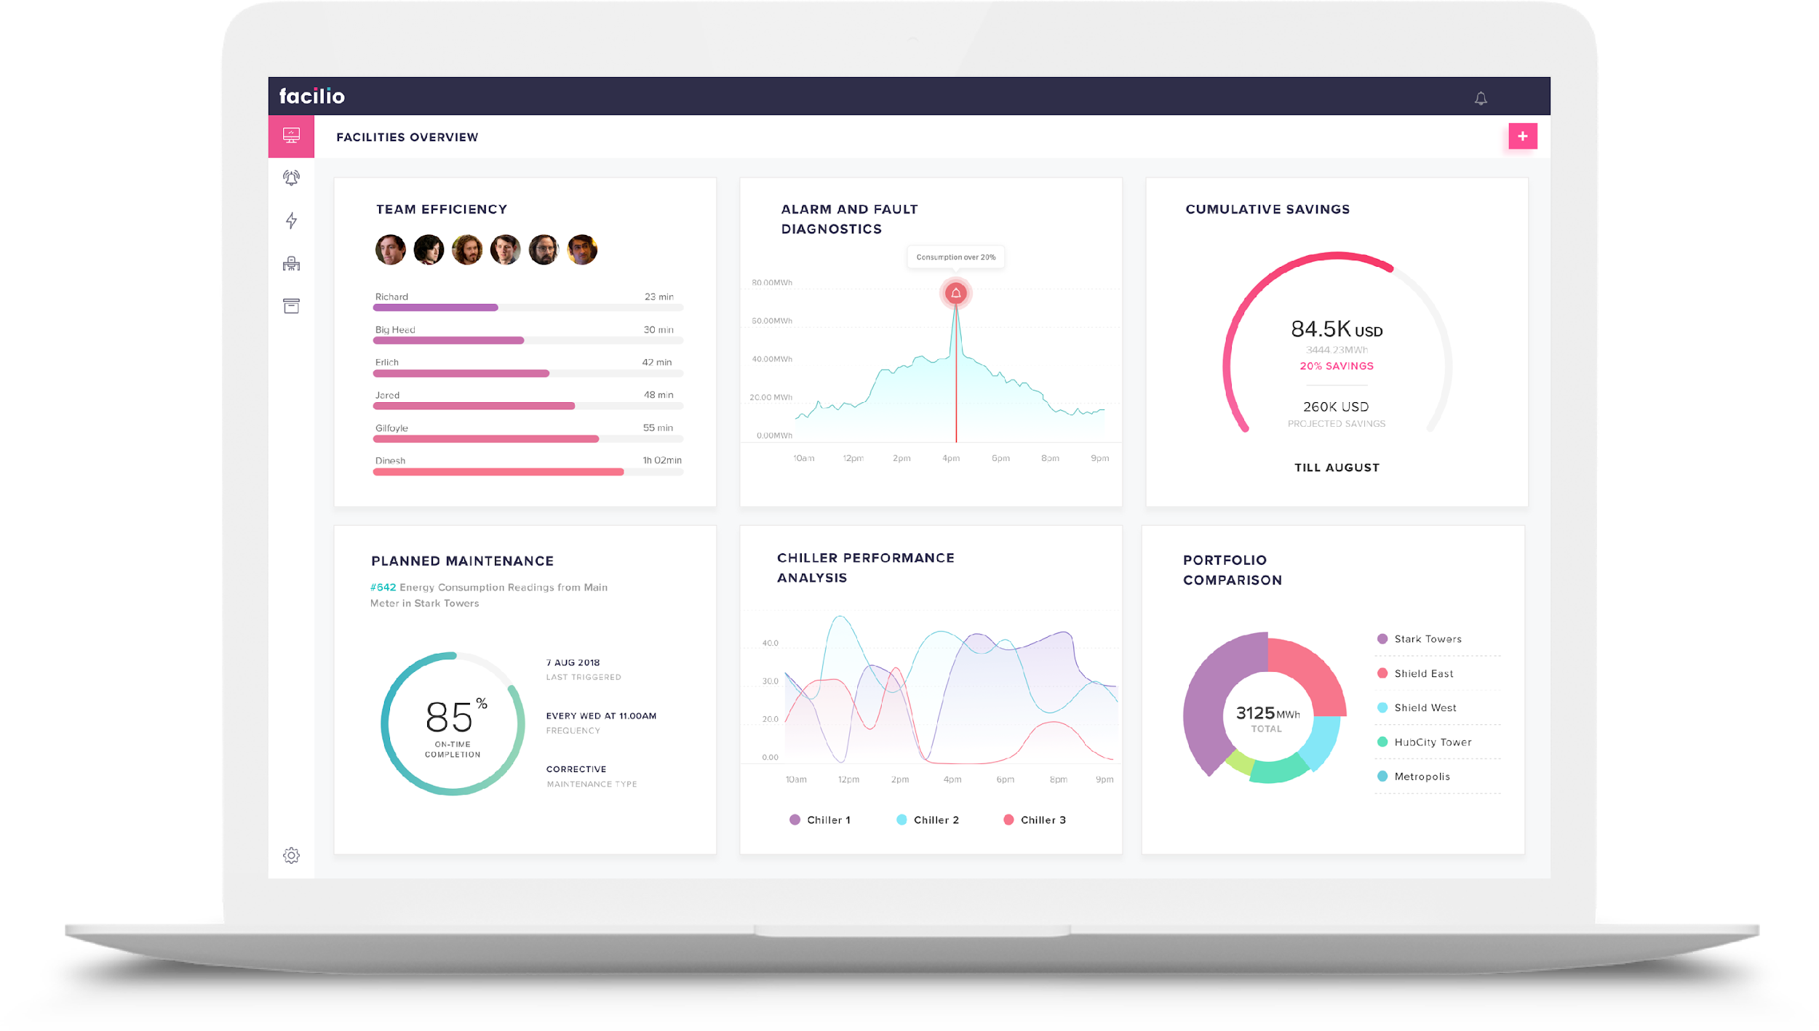
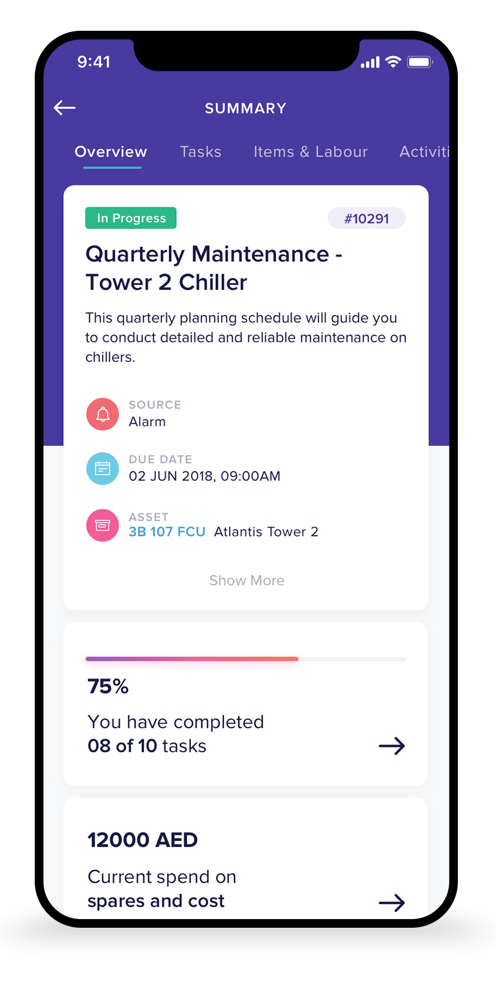
The Facilio Ops Cloud
A platform that augments / consolidates legacy systems
Facilio’s AI-driven platform reimagines how properties are operated and maintained.
It aggregates hard-to-access building data across the portfolio onto a single platform by connecting with existing automation systems, sensor, and devices – in weeks, not months.
This data works with a suite of AI-enabled SaaS appS to optimize building performance, remotely control spaces & assets & elevate tenant experience – all from one place.

Slide 5
















TODAY’S WORLD
Operational inefficiencies and lost value
CHALLENGES
Lack of real-time data
Restricted information flow
Higher operational risk/costs
Limited visibility for decision making
Overlooked opportunities
AUTOMATION SYSTEMS
OWNERS
SOFTWARE
OPERATOR
SERVICE PROVIDERS
TENANT AND OCCUPANTS
WITH FACILIO
BENEFITS
Access to real-time building data
Optimized operations & workflows – driven by AI
Remotely control assets & spaces in portfolio
AUTOMATION SYSTEMS
FACILIO BUILDING
OPS CLOUD
Consolidated portfolio operational data
Empower every stakeholder with real-time insights.
OWNERS
SOFTWARE
OPERATOR
SERVICE PROVIDERS
TENANT AND OCCUPANTS

Slide 6






How it works?
Facilio: Platform Overview
Collect Data
LEGACY AUTOMATION
IOT SENSORS & DEVICES
FUTURE SYSTEMS
BMS, HVAC, Elevator, Fire Safety
People Counting, Camera, Energy
BIM systems, Digital Twin, AR,, Visual AI, Space Planning
Interpret & Analyze Data
Building data is aggregated in real time
Machine learning models are applied to the data to optimize operations
OpsCloud
Use Data to Optimize Performance
Connected Buildings
Tenant
Experience
Maintenance Management

Slide 7





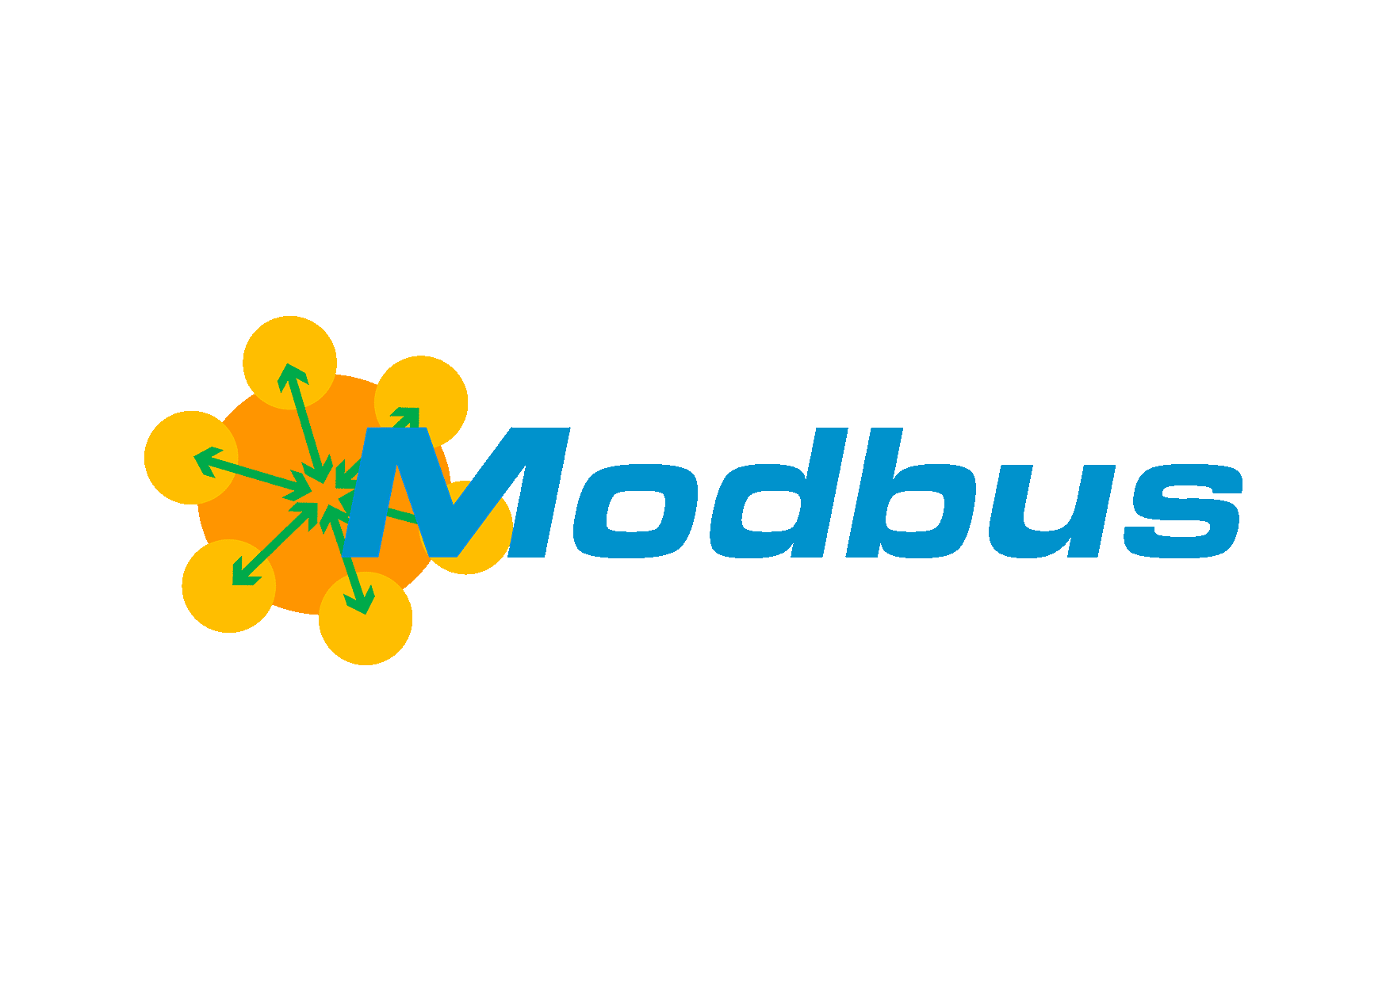
How it works? (Continued)
Automation data is aggregated in the Ops Cloud, a secure cloud environment
Facilio captures data effortlessly from RE portfolios with multi-vendor automation systems & equipment.
A proprietary Internet-of-Things (IoT) driver integrates with BMS, HVAC, Metering, Power, Fire Safety & other systems. The driver uses the Niagara framework & can connect with JACE or other Tridium middleware.
Integration with existing device network is done through open MQTT/REST/SOAP API based communication with controllers.
The driver supports all standard protocols including BACNET/IP, Modbus, OPC, oBIX etc.
BuildingOps Cloud
OPC
…
SENSOR
NETWORKS
HVAC
SECURITY
LIGHTING
METERING
…
COMPLEX MULTI VENDOR AUTOMATION ENVIRONMENT

Slide 8
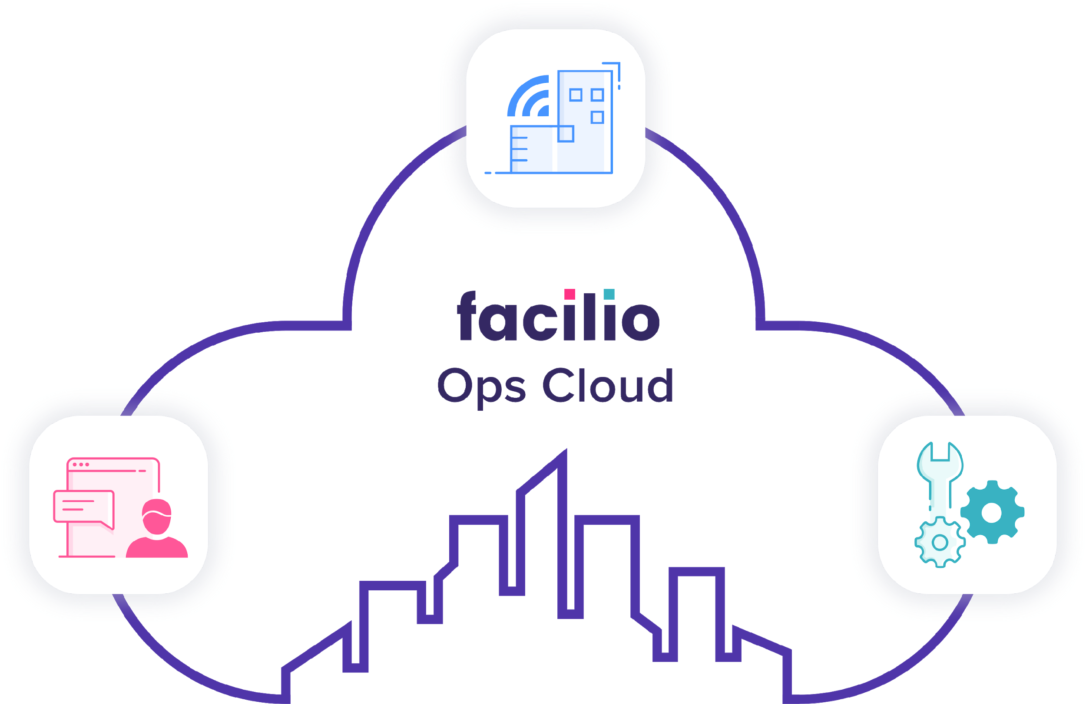





Cloud–native Applications
A suite of SaaS application harness the BuildingOps data in real-time
A single platform that seamlessly connects your entire operations and unlocks value for owner, operators, and tenants.
Connected
Buildings
Build a complete operational picture of your entire portfolio – in real time.
Tenant Experience Management
Maintenance Management
Derisk operational liability.
Reduce carbon footprint
PLATFORM ADVANTAGES
Enhance tenant engagement
Modular Pricing
Secure
3 Party Integrations
(ERP, Business Systems)
Mobility
Collaborative
Unlimited
Upgrades
Automated Workflows
Configurable
Increase asset value & reduce operational cost

Slide 9
Module: Connected Buildings
Turn insights into action
BENEFITS
Surface building data that is yours & do away with vendor lock-in
Monitor & control assets, spaces, buildings & portfolio remotely – in real-time & from one system
Foresee issues with real-time FDD & asset intelligence
Exceed energy savings goals
Apply learnings & automate best practices
FEATURES
CAPABILITIES
FDD
Sustainability Goals
Actionable Intelligence
systems performance | root cause analysis | predictive maintenance
energy use | comparative performance | tenant billing
customized reporting | trend analysis | automated operations

Slide 10
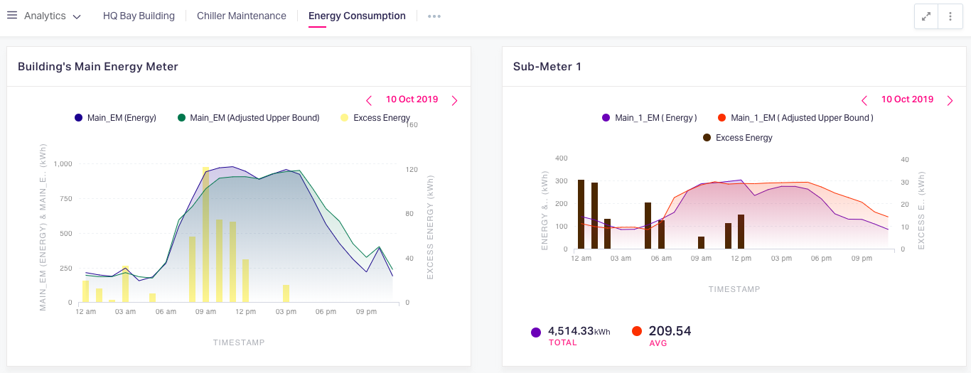
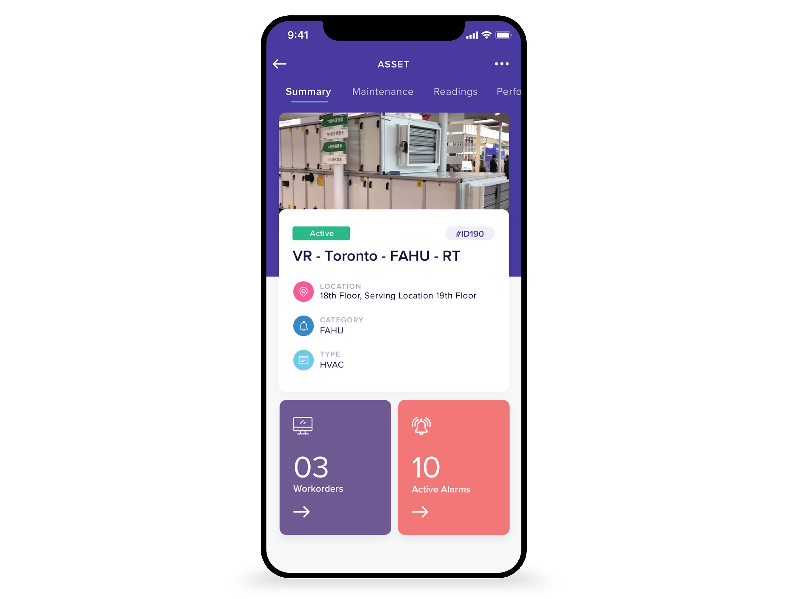
Module: Connected Buildings
Dashboard View

Slide 11
Module: Tenant Experience
Offer a world-class experience & retain tenants
BENEFITS
Automate resource booking
Reduce work order friction by digitizing operations
Reduce churn by improving & measuring tenant satisfaction
Secure buildings & reduce liability with comprehensive visitor, vehicle & vendor management
FEATURES
CAPABILITIES
Resource Booking
Visitor Management
Vehicle Management
Communications
Vendor Management
resource information & availability | book & approve | resource usage
invite guests | check-in | notifications | watchlists
parking | deliveries | security & check-in with pre-approved COI
tenant portal | notifications | creating service requests | feedback
vendor portal | check-in | tracking | contact directory

Slide 12
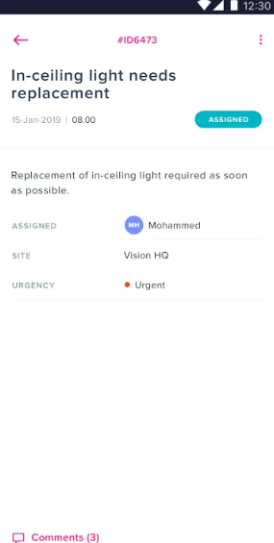
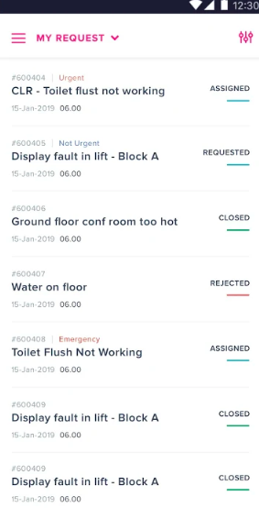
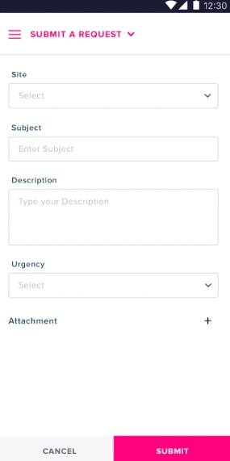
Module: Tenant Experience
Dashboard View

Slide 13
Module: Maintenance Management
Streamline portfolio-wide operations
BENEFITS
Reduce operational costs & optimize workforce productivity
Shift your team’s focus: proactive from reactive !
Ensure timely & accurate job completion
Extend asset life cycles with real-time monitoring
FEATURES
CAPABILITIES
Work orders
Maintenance
Inventory Management
create, assign & close out work orders | track orders across all stages | workforce productivity | customized reporting across all levels of the organization
preventative maintenance | asset tracking | document management
availability of spare parts | rules-based automated restock requests | historical analysis & trends

Slide 14
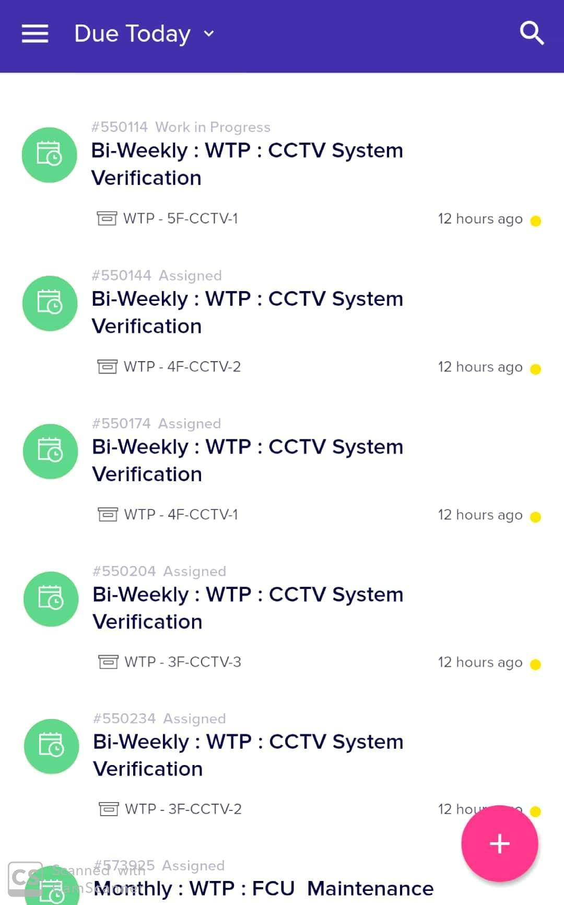
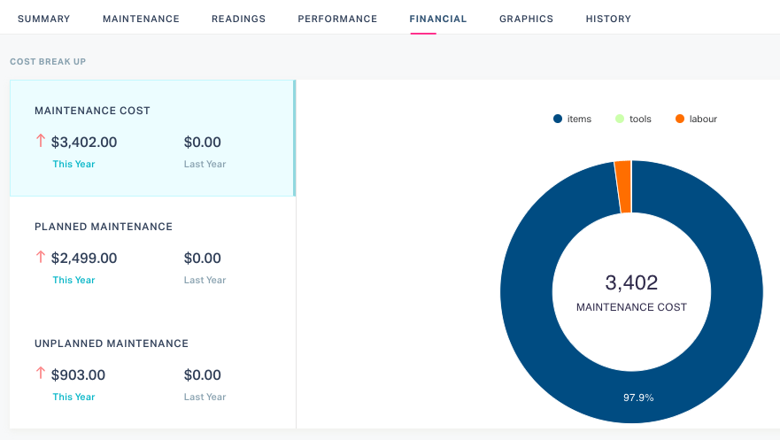
Module: Maintenance Management
Dashboard View

Slide 15



Value Proposition
Facilio helps clients improve efficiency & operating margins.
Vertically Integrated Owners
Real Estate Funds
Operating Partners / Operators
BENEFITS
BENEFITS
BENEFITS
Lower operating costs
Control portfolio performance from one place
Automate time consuming, manual processes
Leverage building data to benchmark equipment, performance, energy usage
Get a complete picture of portfolio in real-time
Reduce tenant churn
Increase net asset value & drive superior investor returns
Optimize costs & reduce waste
De-risk operational liability
Build investor confidence through automated reporting of operating metrics & ESG data
Generate additional revenue through retrofits & asset upgrades-as-a-service.
Differentiate properties through operational excellence & attract new tenants
Provide ownership group with automated, real-time reports on building performance, trends, and service level adherence
Enhance staff productivity by better collaboration & proactive service approach
Increase tenant satisfaction

Slide 16
Post-COVID Recommendation
Reprioritizing for tomorrow: Futureproof buildings via remote BAS operations
RECOUP LOSSES;
RE-EXAMINE WORKFORCE
VIRTUAL COMMAND CENTRE
TOUCHLESS CONTROLS
Re-examine workforce needs to meet new operational budget.
Enable cloud-based BMS/BAS monitoring and control.
Eliminate need for site engineer to step foot inside building.
Perform controlled BAS shutdown and restart without.
Reset temperature/pressure set points based on season and occupancy.
Establish virtually unified, mobile-enabled, lean BAS management. Remote outline sequence changes, resets, and control updates.
Utilize a centralised canvas of building control systems.
Eliminate redundant inspections.
Automate field-team workflows reducing physical presence.
Manage energy efficiently for operational profitability.
Enable tenants to control AirCon, lighting, elevator, and access systems using a mobile app.
QR-code based visitor entry from handheld device.
Track space, assets, and people that red-flagged visitors interact with.
Respond transparently to occupant needs with automated workflows and command actions.

Slide 17
Post-COVID Recommendation
Navigate OPEX reduction challenges, without compromising on efficiency.
Automation
& Mobility
Predictive Operations
Energy Savings
Productivity: Enable mobile workforce, securing optimized productivity.
Digitization: Enable fully automated routines and workflows, reducing unplanned requests.
Portfolio-wide FDD: Connect building systems and run centralised FDD across sites.
Condition-based & Predictive Maintenance: Integrate FDD with automated resolution, at 1/5th cost and speed.
Granular sustainability: Efficiently manage energy a/c portfolio and run effective ECM for operational profitability.
Defer new capex: Connected assets are monitored for failure prediction, wear and tear signs, deferring replacement/repair.
3x
time saved per person
~25%
of hard services cost saved with prediction
10-20%
energy savings without retrofit

Slide 18

Post-COVID: Useful Features
Rethinking RE operations for post COVID world
MAINTENANCE
MAINTENANCE
TENANT ENGAGEMENT
Preventive Routines
Optimized Inventory
Visitor Tracking
Cleaning and disinfection of high touch areas
Increased frequency
Hourly reports, daily dashboards
SLA and notifications
Transparency w/t tenants/owners
Track essential inventory
  Protective gear
  Essentials (sanitizer, disinfectant, garbage bag, cleaning equipment)
Optimize and mandate usage
QR-code based visitor entry from handheld device
Wellness and travel history
Track space, asset, people red flagged visitors interact with.
Aid authority to identify clusters
CONNECTED TENANT ENGAGEMENT
CONNECTED BUILDINGS
CONNECTED BUILDINGS
Touchless Control (mobile app)
Remote BAS Management
Portfolio Command Center
Mobile-enabled control over ambient (HVAC, lighting) and touchless elevator activation.
Contain spread of viral outbreak; regain confidence
Cloud-based monitoring and control of BAS/BMS.
Failure prediction
Controlled BAS shutdown and restart to ensure optimal capacity, avoid flooding.
Fault detection & diagnostics at portfolio scale.
Execute condition-based maintenance
Optimize maintenance for limited workforce hours; avoid redundant contact activities (readings, inspections, rounds).

Slide 19




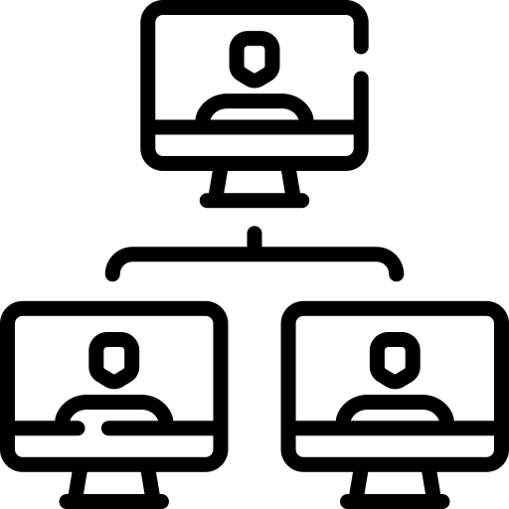









Post COVID: Value Proposition
How can companies prepare for the new normal with Facilio?
FM SERVICE PROVIDERS
& 3rd PARTY OPERATORS
PROPERTY OWNERS & LANDLORDS
Precautionary Measures
Prioritized Service Request
Optimized Inventory
Visitor Screening
Remote BAS operations
Granular Energy Mgmt
Touchless Tenant Egmt
Automated Maintenance
DIGITIZE COMPLIANCE AT SCALE
REDUCE OPEX
Modernize Soft &
Hard Services
Zoomed-in Exec Visibility
Transparency with Landlords
Lean Workforce
Portfolio-wide Control
Increased Tenant Confidence

Slide 20
Customer Success
How has Facilio transformed property operations so far ?
A facilities management services client experienced 13% increase in workforce productivity within 5 months of adopting Facilio.
A real estate owner shaved 33% off energy bills portfolio-wide by implementing a retrofit project monitored by Facilio’s platform.
One of the world’s best known buildings predicts asset inefficiencies 4 days in advance with 90% accuracy.

Slide 21
About Facilio
Company Overview
Global company - headquartered in New York City, with offices in India, Dubai & Singapore
70+ headcount & growing team
40+ million square feet managed across 350 buildings in the US, the Middle East, India & Brazil
Working with prestigious buildings worldwide
Compelling value proposition – on track to add 15 million square feet in the US & 10 million square feet in Brazil by March 2020
Investors include Accel Partners & Tiger Global

Slide 22

About Facilio
Our Journey
Successful Pilots
sq.ft managed by Facilio
Built the Facilio IoT Platform.
Developed strong partner ecosystem.
Deployment with major Middle East, South American, and Asian players.
150m
40m
20m
2017
2018
2019
2020
IoT for Buildings
Customer Success & Expansion
Accelerated Impact
Industry gap: no solutions that were designed for building ops.
Incorporated after validating gap.
Raised seed capital from Silicon Valley investor (Accel).
Built a team of IoT experts, top SaaS leaders (ex-Zoho veterans).
Launched BuildingOps Cloud and expanded deployments with US RE companies
Rapid expansion in US market a/c verticals (class-A office & healthcare facilities)
Full-filled long term deployments large Govt. projects and leading real estate players
Regional offices in US and Singapore

Slide 23

Property Operations. Reimagined.

