Slide 1
Data Democracy in CRE
Liam Murray, Build-Apps

Slide 2




Commercial Real Estate Scenarios
You are responsible for Capital Expenditure budget due next week | You are responsible for billing your tenants based on meter data
The head of asset management has asked to shave $10M off whilst maintaining safety and asset. performance | There is a data breach and the third-party meter data service provider locks out all.
You are responsible for the sustainability performance of a portfolio | You are responsible for the maintenance procurement
Your CEO decides on a new ESG Target. You must gather the performance data to support the Targets. | Your National services maintenance contractor for your entire portfolio data goes bankrupt.
2

Slide 3
Status Quo with CRE data
You lack data security, ownership and integrity
You're reliant on spreadsheets and various 3rd party SaaS (software as a service) vendors
You have ever increasing silos of data
You have increasingly complex Investor Reporting Metrics
You lack business group cross pollination of datasets
3

Slide 4
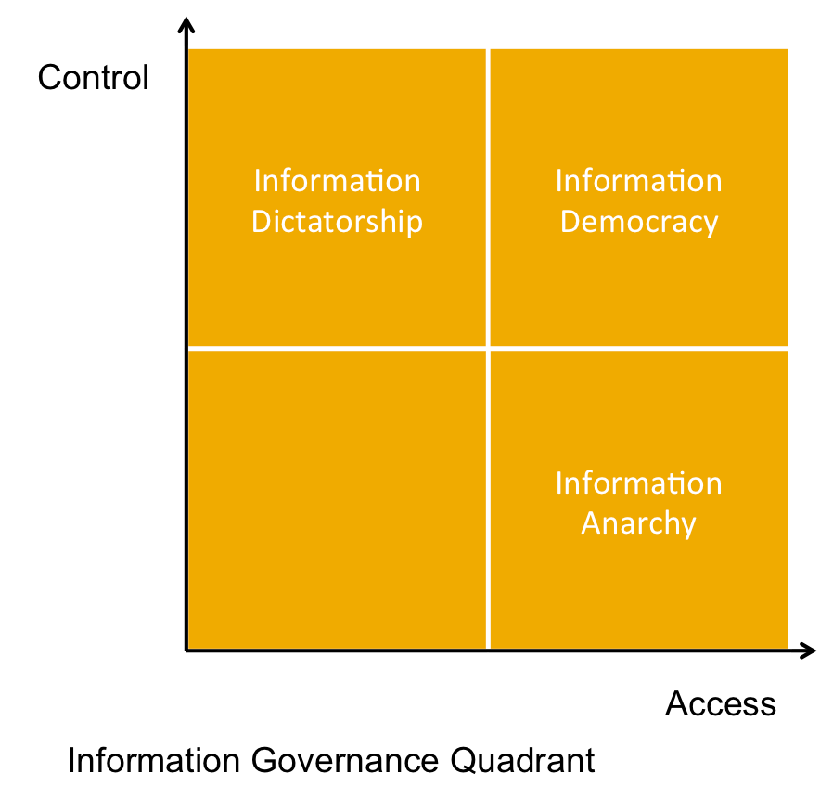
Data Democracy
The term 'data democracy' describes the concept of an ideal system in which we can all access the same data in a relevant, timely and equitable way
Information Dictatorship
Information Democracy
Data
Prison
Information Anarchy
4

Slide 5
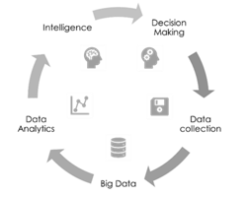
Benefits of Data Democracy?
Data Democracy:
Allows property owners and decision makers to view the same live macro holistic picture of whole-of-portfolio data.
Facilitates scrutinization at a micro level to strengthen portfolio performance, increase asset valuation and improve operational efficiency.
Enables building performance analytics and insights into a property portfolio.
5

Slide 6
No Data Democracy, what are you risking?
Data Hoarding
There is an historical trend for personnel (internal or external) to claim ownership of data
Data Ransom
Ensure clarification around exiting the service. Exiting can be costly and cause major loss of data. There are no published standards that apply in this new Proptech sector..
Lack of documentation and/or APIs
API enables integration of building or company specific data with some cloud systems. Portfolio specific data may be compromised by making it fit into the templating requirements of a particular SaaS provider.
6

Slide 7
Why is Data Democracy so important?
Data is a valuable entity that drives profitable activity within the real estate sector and includes knowing the complete and detailed history of all assets in your building and maintaining complete data records.
By having access to your data, you have complete and unconstrained control, with no dependence on a 3rd party and no risk of losing it due to their faults or clauses in their service agreements.
Data ownership reduces reliance on third parties and avoids the pitfalls of the Proptech sector, which has seen a boom in cloud-based start-ups, according to leading industry magazine Unissu, more than 7,000 individual SaaS providers have emerged over the past 5 years.
7

Slide 8
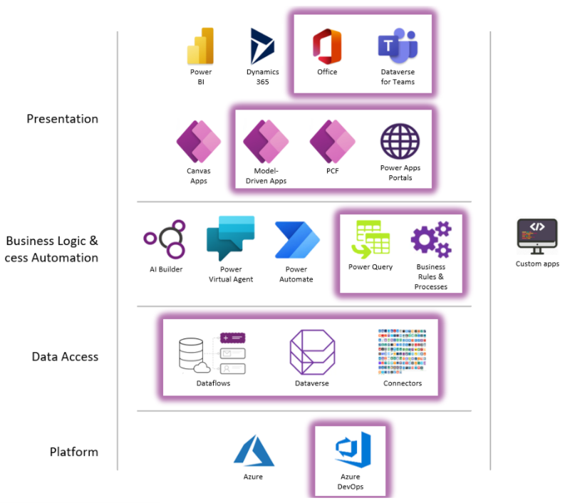
The Microsoft Power Platform and the Dataverse
8

Slide 9
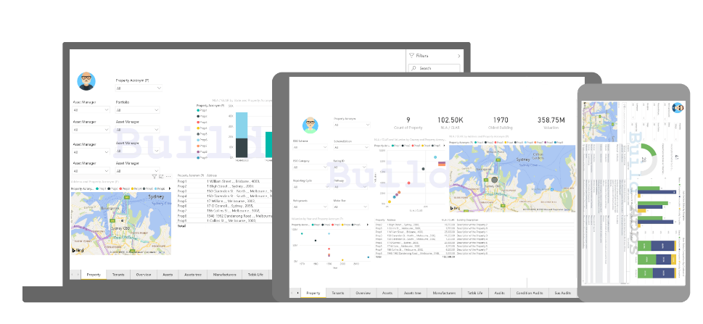
ADAMM & Co.
Enabling
Commercial Real Estate
Dataverse Democracy
Using our opensource 365 solutions, Build-Apps ADAMM & Co. suite
creates a CRE Dataverse Democracy: owned, controlled and governed by
the portfolio owners
9

Slide 10
What's different about ADAMM & Co.?
Not a SaaS – Software as a Service
SaaS is managed by a third party
Costly APIs required to integrate data across platforms
Lack of data integrity across the portfolio
You don’t manage the Data in SaaS
Is an APaaS – Applications for Platform as a Service
Your Microsoft 365 environment is your platform
ADAMM & Co. has the ability to integrate with any other platform
Dataverse accessible across the business with appropriate internal
Your security controls and policies
Complete portfolio data integrity across the entire portfolio

Slide 11









Solutions not SaaS
SaaS - Problem
PaaS - Solution
Data ownership – Data usually stored by SaaS provider which creates added risk.
Interoperability – Influx of platforms without the ability to share data without intervention.
Security – Under the SaaS model the vendor is responsible for managing sensitive data.
Business Intelligence – No single source of truth across the entire organisation. Scattered information across platforms and Excel spreadsheets.
Artificial Intelligence and Machine Learning – Futureproofing and innovating is difficult under SaaS model and highly dependent on vendor.
Data ownership - Layer of Apps within the clients Office 365 and the underlying data is stored, backed-up and owned by the client.
Interoperability - Secure 2-way API connection. Connectors allow secure and control integration from other sources.
Security – Microsoft architecture. Office365 single sign on AAD integration allows security to be controlled by the enterprise not external parties.
Business Intelligence - Power BI dashboards give ultimate flexibility for analytics while connected to multiple sources.
Artificial Intelligence and Machine Learning - Integrated throughout our application, from picture recognition to document data extraction.

Slide 12









ISV (Integrated Software Vendor Service)
Sales
Support
Develop
Direct and on the Microsoft Appsource as our shopfront
Ongoing customer support services
Promote client requested development and customizations0
Targeted
Customizable
Offering managed solutions for CRE
Clients can customize through Microsoft
Tested
Accessible
Deployed on over 38 million M$ of property
Your entire organization can use the apps
Adaptable
Symbiotic
Infinitely adapting to the digital unfolding digital landscape
Responsive to client’s needs as they emerge0

Slide 13












ADAMM & Co. Suite of Apps
ADAMM & Co. is an evolving family of applications who
all share the same Dataverse, creating a complete
CRE Data Democracy

Slide 14
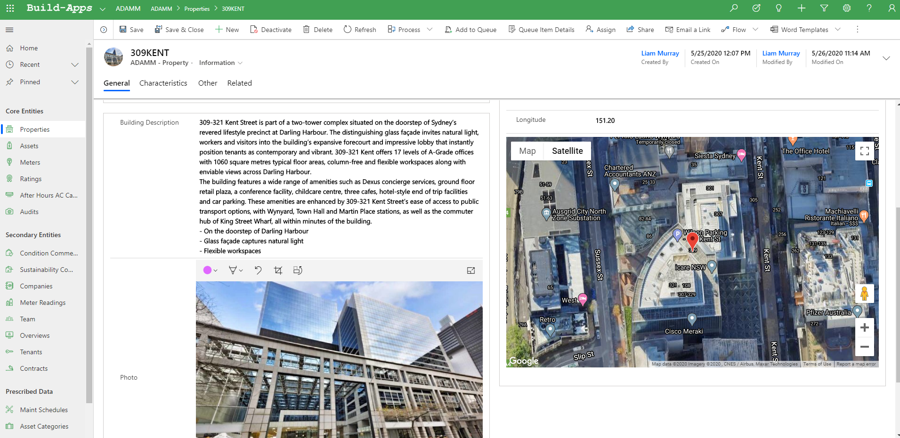
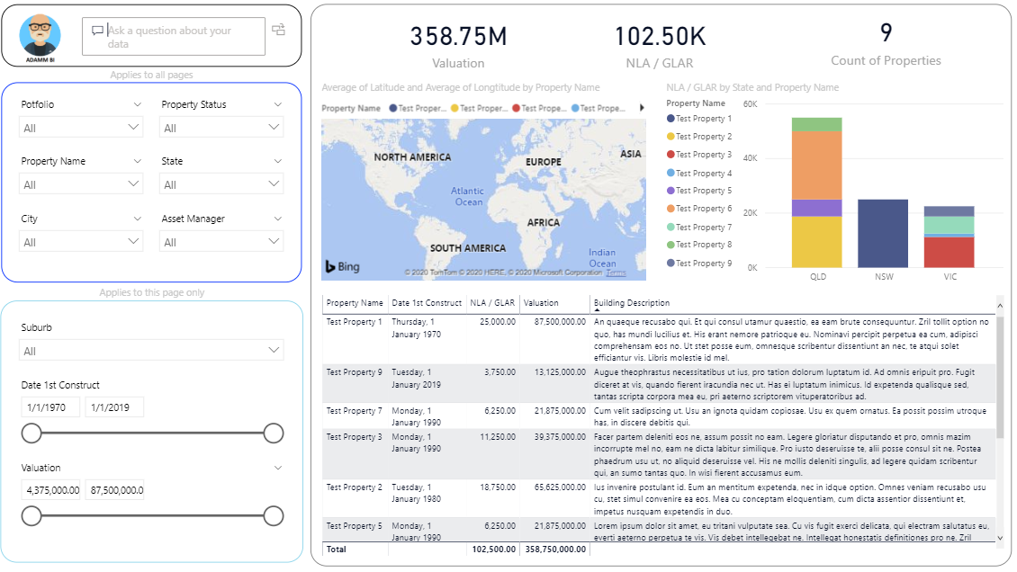
ADAMM
ADAMM is the grandfather of the CRE Dataverse Democracy
ADAMM is your App to optimise asset performance, track leases and contracts, develop strategic improvement plans based on performance, and benchmark and log and share portfolio-wide asset history of real performance.
14

Slide 15




ADAMM & Co. Suite of Apps
SERGII
(Social, Environmental, Resilience, Governance Indices Improver)
SERGII maintains data on how your business is tracking in terms of sustainability and takes care of all data relating to the social, environmental, resilience and governance (ESG) aspects.
REMII
(Real-time Enterprise Metering with Integrated Intelligence)
REMII enables real-time analysis of energy use per building across the entire property portfolio to develop and implement strategies to achieve energy and water targets.
CHRISS
(Compliance Hazards, Risk, Inclusivity & Security Systemizer)
CHRISS offers a proactive approach to risk management and risk mitigation. Creates an exchange with building occupants, prioritizing inclusivity, ensuring wide representation on OH&S matters.
BARRIEE
(Building Annotation Real-time R0ecording and Interoperability Exchange Examiner)
BARRIEE monitors BMCS against fault detection platforms to ensure a building is running optimally. Easy to understand dashboards give mapping and data transparency.
Several other Apps are available, or can be custom developed on request

Slide 16




ADAMM & Co. Suite of Apps
MATT
(Maintenance of Assets Task Tracker)
MATT is the ultimate integration tool for planning, preventative maintenance and collecting all asset maintenance data. Create a seamless, accessible and secure maintenance environment to stay in front of maintenance requirements
PAMM
(Project Administration Matrix Manager)
PAMM is a repository for all projects undertaken across the property portfolio. Creates an easy to view snapshot of all the diverse, cross department projects and can inform operational and capital expenditure.00
ISLAA
(Investment Strategy Liability Auditing Analyzer)
ISLAA provides an overview of any given building to make Commercial Real Estate investment modelling logical, simple and time-efficient. ISLAA is your property investment solution to the complexities of real estate valuation.
CAMM
(Commissioning Activity Matrix Manager)
CAMM stores the commissioning documentation and scheduling. Assessable to contractors and the Independent Commissioning Agent. CAMM ensures that the client’s intent for a project is maintained to delivery.

Slide 17




ADAMM & Co. Suite of Apps
OBIEE
(Office Building Improvement Enterprise Evaluator)
OBIEE creates a comprehensive property investment database allowing analytics of potential investments, collating data across industry to determine the quality of the office space.
SITAA
(Security and Information Technology Auditing and Assessment)
SITAA likes to sniff the properties network creating a digital map of all network infrastructure. She store audit logs in detail and summarizes up for high-level view. Purpose is to provide summary of network topology per building and flag any high-risk issues.
VERAA
(Vertical Transport Entrapment and Risk Analysis Assessor)
VERAA creates a single source of truth for all vertical transport systems in the portfolio. Incident reporting and lift KPIs can be uploaded to maintain a live analysis of all VT performance. Connecting to the VT industry leader's data sources is a VERAA’s specialty
SIAA
(Servicing and Invoicing Automated Assistant)
SIAA is the grandmother of the suite she provides a real time app costing and support services for all of the ADAMM & Co. suite. optimizing embedded ticketing and support is what SIAA lives for

Slide 18
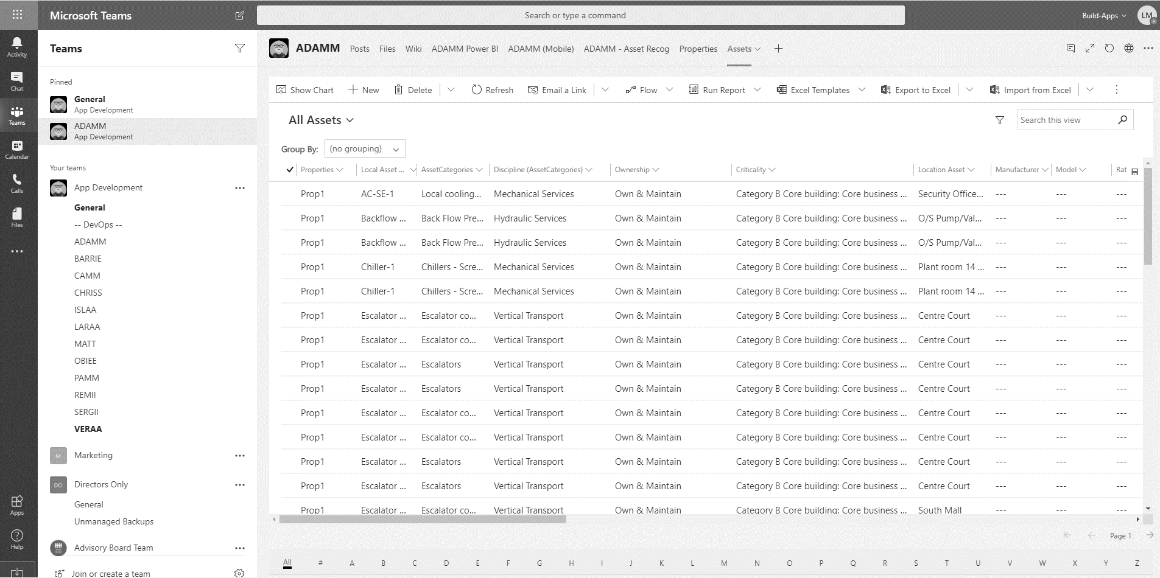

Benefits
Deep Teams Integration
Teams

Slide 19
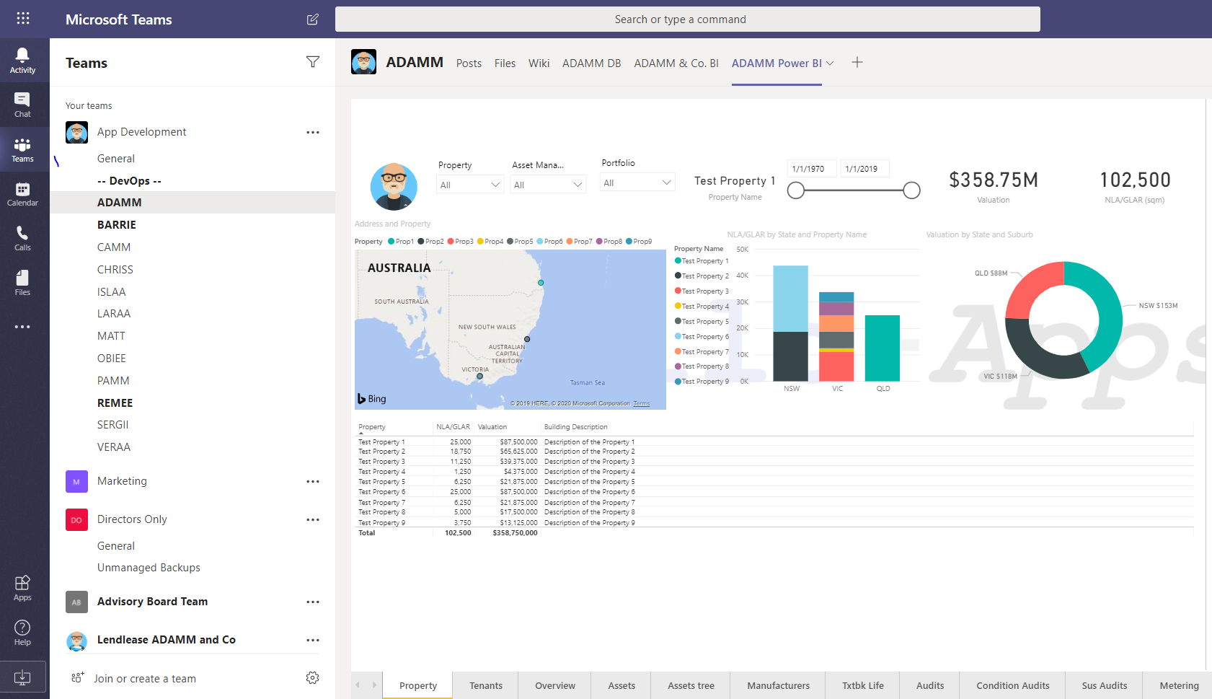


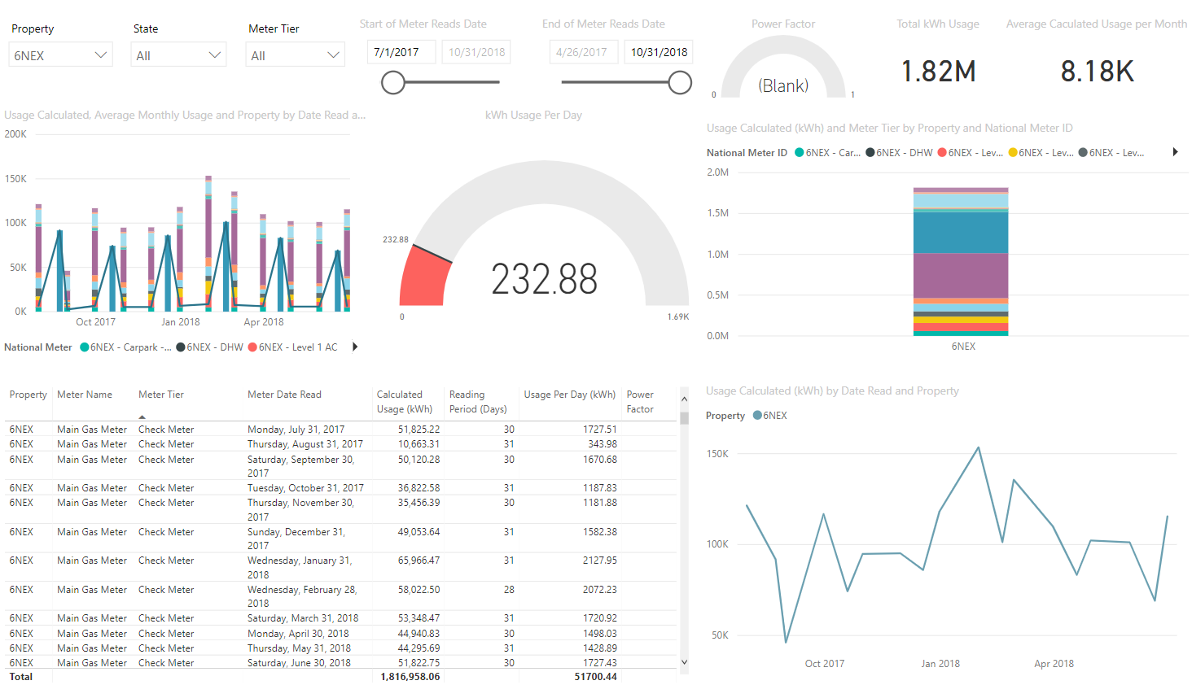
Benefits
Deep BI Integration
Other benefits include
Unlimited visualization options
Unparralleled dashboard
Unrestricted client customization
Unlocks machine learning opportuntities

Slide 20



Benefits
Customization
Completely unrestricted client customization available
Activly support our client IT teams to invovate and create their own apps
Enables clients to have their own DNA embedded into ADAMM & Co.

Slide 21
Thank you
Liam John Murray
Founder, CEO
+61 479 187 297
Liam.m@build-apps.com

