Slide 1
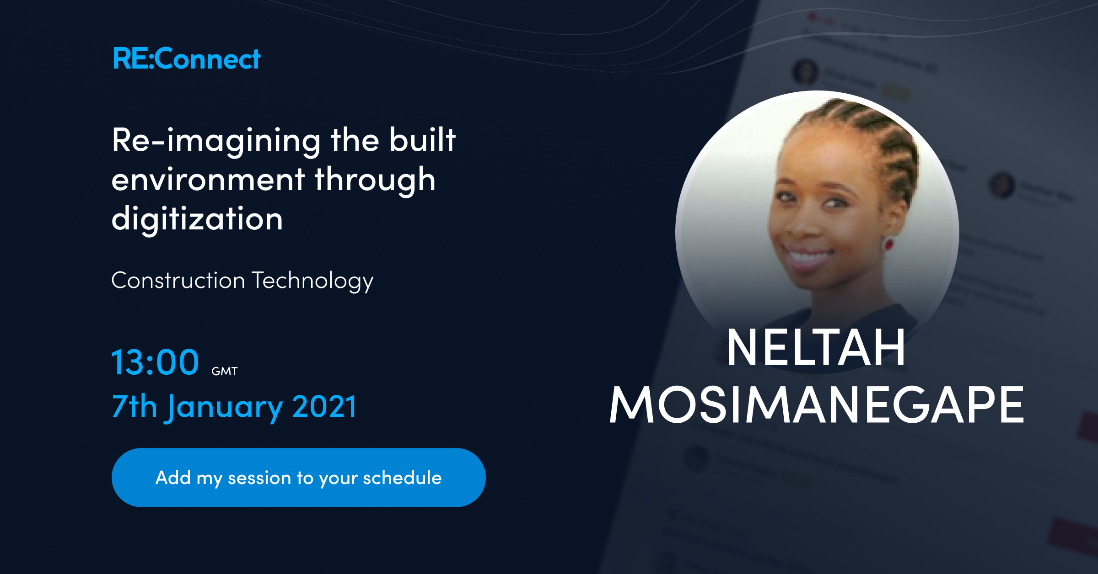

Notes:
NELTAH TSHEPISO MOSIMANEGAPE BIO
Neltah is a property professional and founder of Tempest Gold, which focuses on transforming the property/facilities management, marketplace services and research sectors through technology and innovation. It’s listing app had been selected as one of Demo Africa’s 2018 Top 30 startups. Its latest offering, ‘MRSP'; a digital property management toolbox.
In 2019, she was named the ‘Women in Africa’ Botswana laureate and also named the ‘Young Property Person of the Year’. Tempest Gold has been internationally recognized in 2020 by ‘Wealth & Finance International’ and was awarded the coveted ‘Best Woman Owned PropTech Start-Up 2020-Africa’ award at the organization’s annual FinTech Awards.
Neltah possesses a MSc in Project Management from the University of Bolton. She is currently studying towards a Doctorate in Real Estate and a Certification in Big Data Analytics. She has sat on various boards in Botswana. Currently, she produces and hosts her own real estate talk show, called ‘Real Estate with Neltah’.

Slide 2
        Re-imagining the built environment through digitization
        Presentation by Neltah Mosimanegape (Tempest Gold-Botswana)

Slide 3
WHY DIGITIZE THE BUILT ENVIRONMENT?
Notes:
Pre-Covid 19: Digitization in the built environment has gained traction with the advancement and increasing popularity of Property Technology and Construction Technology
During Covid: the need and importance of digitization became evident forcing stakeholders to adapt to the changing environments.
During and Post-Covid: We need to re-imagine the industry and built environment as much as possible and incorporate and digitize operations in the built environment. This presentation will shed insight on how we can re-imagine the industry, adapt without compromising effectiveness and efficiency but rather increasing productivity

Slide 4
DIGITIZATION OPPORTUNITIES
Drone Technology
Mobile/app/web-platform technology
Building Information Modeling
Digital Post-construction building/facility management

Slide 5
DRONE TECHNOLOGY
Notes:
Drone technology is increasingly becoming popular in a lot of industries, and the built environment is not an exception. The video coming up shows us some opportunities that drone technology provide (SOURCE: YouTube)
Benefits of drone technology:
Aerial Imaging data: collection of pictures and videos
Monitoring of construction progress can be done remotely
Reduces injury and safety risks
Precise mapping and measurements
Job creation in construction tech

Slide 6
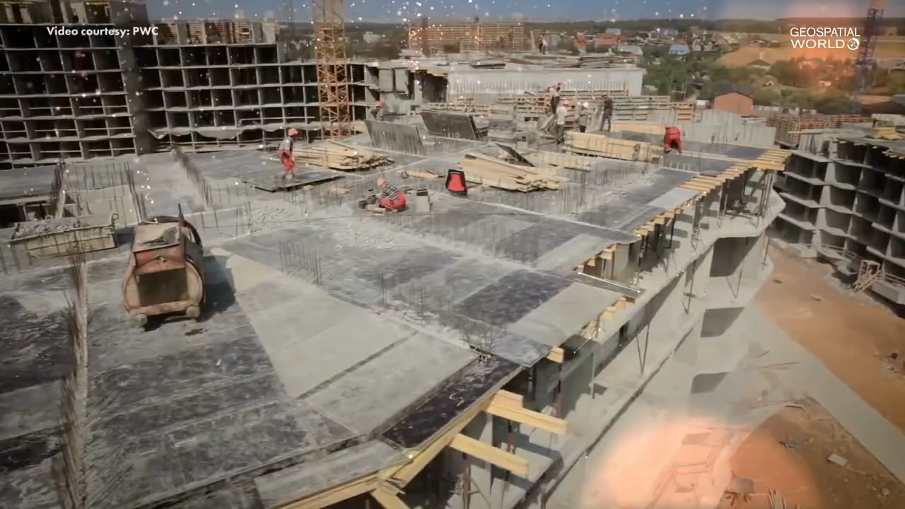
DRONE TECHNOLOGY
Notes:
SOURCE: YouTube: https://www.youtube.com/watch?v=Tm3NXhGLvuU

Slide 7
MOBILE/APP/WEB-PLATFORM TECHNOLOGY
Notes:
Mobile/App/Web-platform technology
Digital platforms allow for the development team (stakeholders: project managers, construction company, employees, etc) to be kept abreast of the construction progress and developments
Real-time information is shared
Reports can be shared digitally
It reduces the requirement of many ‘in-person’ meetings

Slide 8
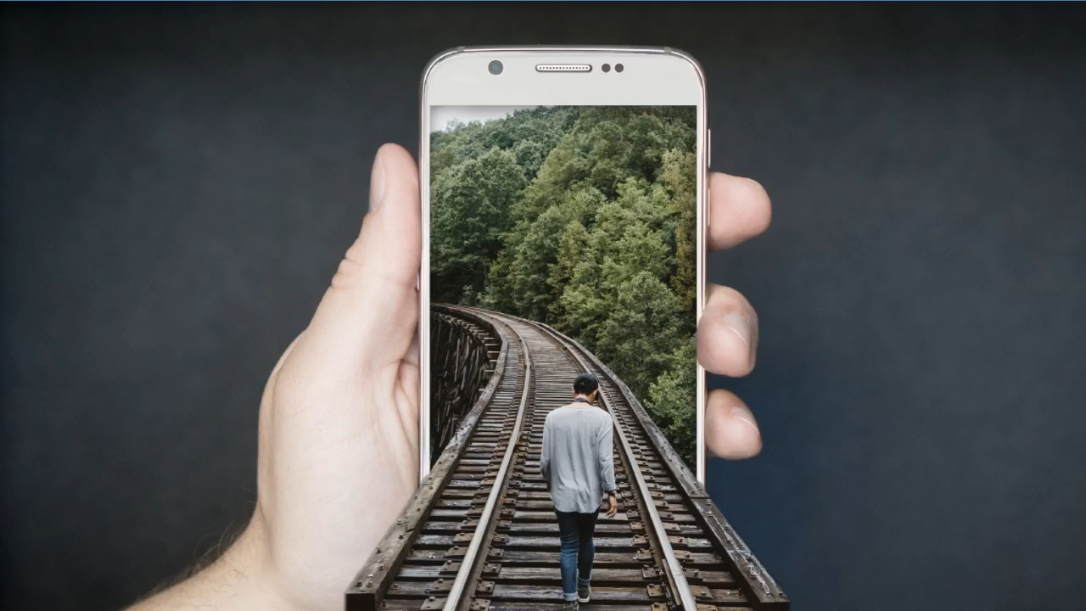
DRONE TECHNOLOGY
Notes:
SOURCE: YouTube: https://www.youtube.com/watch?v=Wbj84er8T7s&t=7s

Slide 9
BUILDING INFORMATION MODELING (BIM)
Notes:
What is BIM? s This is a modeling of the functionality and physical characteristics of a building/facility during the construction life-cycle from beginning to end (including management and demolition if necessary).
The following are covered during BIM:
How the spaces will look like
The sequence of construction
The systems that will be put in place during the building life-cycle

Slide 10
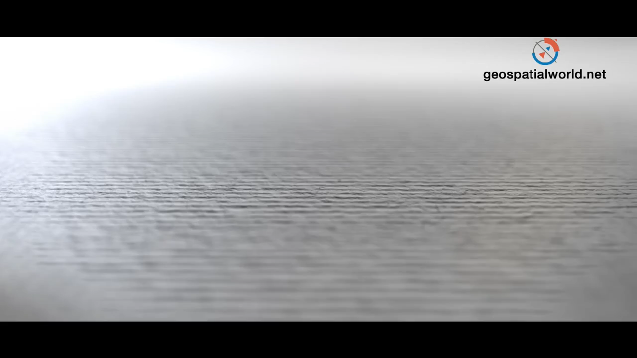
DRONE TECHNOLOGY
Notes:
SOURCE: YouTube: https://www.youtube.com/watch?v=0J0d-LjInEU

Slide 11
DIGITAL POST-CONSTRUCTION BUILDING/FACILITY MANAGEMENT
Notes:
The management of buildings and facilities post construction are one of the last phases of the building lifecycle.
Cloud-based facility management platform simplify the job in the following ways:
Accessible anywhere in the world
Direct contact between the building occupants and the facility/building managers
Ability to log maintenance calls by occupants, have them received by the building manager, enable both the occupant and building manager to track and comment on the level of satisfaction of the service provided
Data collection on recurring maintenance issues and snags upon completion of the building construction

Slide 12
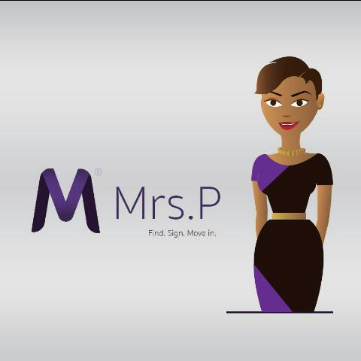
MAIN
TITTLE

Slide 13
END OF PRESENTATION
Please feel free to connect and network with me on the below social media platforms:
Email: info@tempestgoldbw.com
WhatsApp: +267 72 196 950
LinkedIn: https://www.linkedin.com/in/neltah-mosimanegape-mreib-411b724a/
Instagram: https://www.instagram.com/neltah_mosimanegape/
YouTube: https://www.youtube.com/channel/UCRQqxjHJ9w_vei7sOd4iRDw
ENQUIRIES, COMMENTS AND BUSINESS/PARTNERSHIP OPPORTUNITIES ARE HIGHLY WELCOME

