Slide 1
Why we Love Stupid AI
JOHN Minns – Independent Group

Slide 2
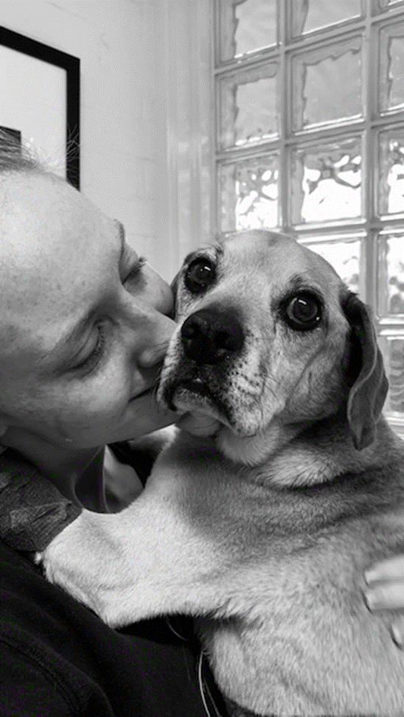
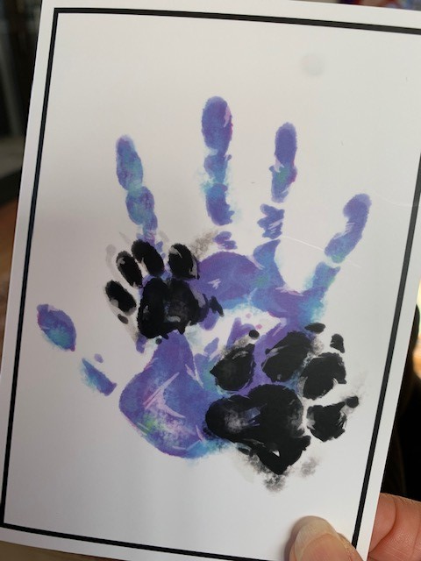
Ollie the Wonderdog
2009 - 2020

Slide 4
Meet Mike & Jess
Complexity
Contingencies
Confidence
Connection

Slide 5
Moments of Truth
A Real Estate agency Business Model

Slide 6
Virtual Agent
24/7
Responsive
Personal
Relevant

Slide 7
Big Data Enabling Performance
Predictive Analytics
Propensity Scoring

Slide 8
Marketing & Communication
Re-Targeting
Marketing Automation
Mass Customisation
Cross-selling Opportunities

Slide 9
Performance
Be a Great Team Member

Slide 10
Create Opportunity
Make the Agent Look Great

Slide 11
Deliver Value
DO: Be a Great Investment
DON’T: Try to Replace Humans

