Slide 1
Real Estate Technology
Threat or Opportunity?
Steve Maarbani, VentureCrowd CEO

Slide 2
Threat or Opportunity?
The real estate sector is undergoing a fundamental transformation, fuelled by technological change that will be more consequential than at any other time in recent history.
Driven by the demand for greater efficiencies throughout the sector and enhanced user experiences, new technologies are reimagining every aspect of the way in which real estate is procured, developed, managed and utilised.
The extraordinary pace of innovation in other industries, and the resulting ubiquity of digital technology in everything from ordering a pizza to managing your finances, has heightened consumer expectations of every other aspect of their lives, including their relationship with the built environment.
In this next phase of real estate sector transformation, the
business of ‘bricks and mortar’ will no longer be about bricks nor mortar.

Slide 4
Defining RealTech
RealTech, short for Real Estate Technology, refers to technologies that impact the built environment and the real estate sector, either through business model innovation or product innovation, affecting the way we live, work and play.
RealTech Categories
Generally, RealTech companies fall into one of the following categories:
Urban Planning
Design & Construction
Search, Sales & Acquisition, and
Leasing & Management.
RealTech companies are reinventing our relationship with the built environment

Slide 5
Lease & Management
Examples include:
List and search services
Peer-to-peer leasing
Inspection management software
Transaction management software
Internet of things
Beacon technology
Tenant screening technology
Lease and revenue management software
Smart building platforms and artificial intelligence
In-venue marketing technologies
Broker back-office and infrastructure
CRM and lead management solutions
Property marketing and sales solutions including social marketing and marketing automation
Urban Planning
Examples include
Urban design software
Virtual reality and simulation technology
Mapping platforms
Satellite technology
Beacon technology
Technology Solutions
Data & Analytics
Examples include:
Big data aggregation and management tools
Information crowdsourcing tools
Content, data and information portals
Tenant and visitor in-venue experience and engagement solutions
Tenant and visitor in-venue loyalty, transaction and value add solutions
Design & Construction
Examples include
Virtual reality and simulation technology
Enhanced architecture and design software
Project and cost management tools
Smart building platforms and artificial intelligence
Construction and workforce management solutions
Building material innovation
Material sourcing platforms
Beacon technology
Project finance and investment platforms
Acquisition & Project Finance
Sustainability
Data & Analytics

Slide 6
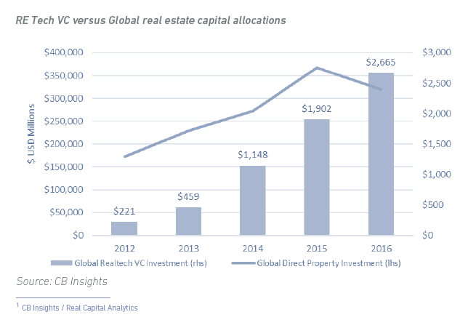
The global growth of RealTech
RealTech, short for Real Estate Technology, refers to technologies that impact the built environment and the real estate sector, either through business model innovation or product innovation, affecting the way we live, work and play.
RealTech Categories
Generally, RealTech companies fall into one of the following categories:
Urban Planning
Design & Construction
Search, Sales & Acquisition, and
Leasing & Management.

Slide 7
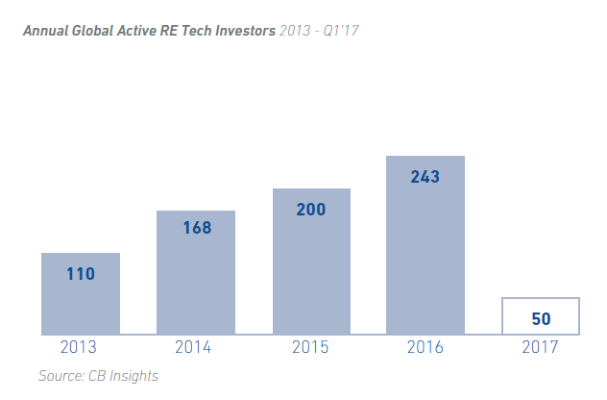
Traditional real estate corporates are increasing their allocation to RealTech venture capital investment
With the long-term outlook for direct real estate capital investment remaining positive, allocations to RealTech will continue to increase exponentially. If venture capital allocations into RealTech continue to grow at the same rate over the next three years, the annual amount invested in RealTech companies by 2020 could reach US$20 billion. This is comparable to the amount that is currently invested in FinTech each year.
Investors
In 2016, CB Insights recorded 243 active RealTech investors. This number has steadily increased year-on-year since 2013. In the first quarter of 2017 there have been 50 unique investors who have participated in at least one RealTech deal. These investors include not only venture capital firms and super angels, but strategic real estate corporate investors, many of which are market leaders. As technology continues to become the new battleground for real estate projects and assets, we expect increased participation and investment volumes into RealTech companies by traditional real estate corporates.

Slide 8
As the allocation of venture capital funding by a increasing band of global investors is deployed to uncovering and developing the RealTech innovation of the future, traditional operators will come under increasing pressure to adapt or perish.

Slide 9
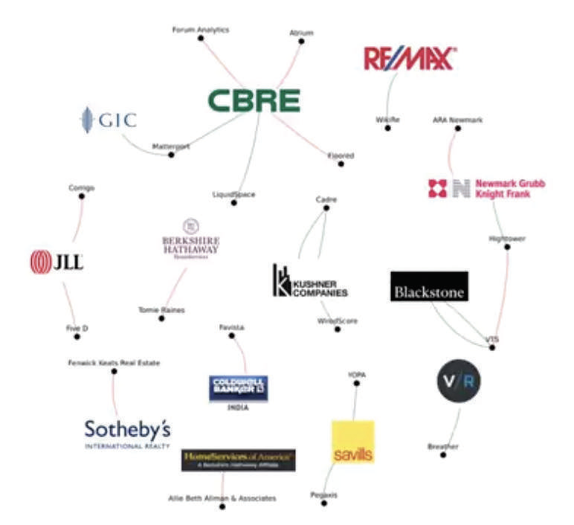
Venture Capital Investment activity of some of the world’s largest real estate corporates.
Drivers
The global growth of RealTech should come as no surprise. The real estate sector is the largest and most valuable asset class in the world, and it has managed to operate into the present day with relatively minimal innovation. As an asset class, direct real estate appeals to a broad range of investors and is seen as a relatively low-risk asset.
As sector participants, such as developers, agents and financiers, continued to profitably provide real estate product to an eager market, many argued there had been very little reason to innovate …until now.
As the allocation of venture capital funding by an increasing band of global investors is deployed to uncovering and developing the RealTech innovation of the future, traditional operators will come under increasing pressure to adapt or perish.

Slide 10
Legacy, Inefficiency and Complacency
Over the last decade, a number of industries that have a material impact on the way we live our lives have been transformed by technology in ways previously considered unimaginable.
For example:
Media & Advertising
Entertainment
Travel
Financial Services
Access & Control
Transparency
Process
Cost
Trust
In the real estate sector today, many of the inefficiencies that drove the transformation of other industries continue to exist. The
opportunities for the removal of low-value intermediaries, empowerment of consumers with greater access to product and transactional control, increase in transparency of information
and trust, and the automation of tired legacy systems to create more user-centric processes across the sector are immediate and potentially very valuable.
These dynamics represent easy wins for technology entrepreneurs and investors.
In this century, cities will be revolutionised.

Slide 11
Consumer Expectations
This pace of innovation in other industries, and the resulting ubiquity of digital technology in everything from finding a job to buying music, has heightened consumer expectations of the way in which they engage with all other aspects of their lives, including they way in which they experience the built environment experience. Social media platforms empowered consumers to access their trusted peer groups to make buying decisions. The likes of Uber empowered consumers with their own virtual fleet of drivers who will deliver almost anything to your door whenever you want it, in a manner that you control on your mobile from the comfort of your lounge room.
The likes of Spotify and Netflix empowered consumers with access to a world-wide music, television and film library that consumers can access on-demand. FinTech startups empowered consumers to search, compare and acquire everything from insurance policies to personal loans with relatively little human contact. In the wake of this, consumer expectations of real estate transactions and their experience with the built environment have been elevated. As innovation in other industries continues to power ahead, consumer expectations will continue to put pressure on the real estate sector to innovate.

Slide 12
Urbanisation
In this century, cities will be revolutionised. According to the 2014 World Urbanization Prospects Report by the United Nations’ Department of Economic and Social Affairs, 54 percent of the world’s population currently lives in urban areas and over 400 cities now have a
population greater than 1 million people. This number is forecast to reach 70% globally by 2050 but will be even higher in regions like the Asia Pacific and Eastern Europe where the average is
closer to 85%
The biggest changes in urbanisation will occur in the Asia Pacific region. Australia, China, India, Japan, and Thailand will see close to 20% of their populations move into urban areas in the next thirty years.
This will be the largest mass migration of people in history, approaching 1 billion people over the next thirty years.
As that migration occurs, the real estate related challenges of urbanization will need to be addressed. Challenges range from the most fundamental, such as the efficient provision
of basic services and infrastructure, to the monumental, such as the development of smart cities.
These challenges will require innovative approaches that leverage cutting-edge technology, real-time data and the most advanced analytic tools. The cities of the future will need to be able to process large amounts of user and environmental data, use sensors and beacons to communicate the health of the city and its infrastructure, and access sufficient energy from sustainable sources.
In that context, RealTech companies will play a leading role in realising the cities of the future.

Slide 13
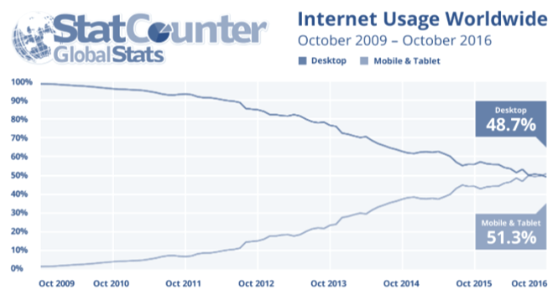
Mobile Technology
In the last decade, smart phone penetration rates have escalated considerably. According to Ericson, there are 2.6 billion smartphone subscriptions globally 3. This number is expected to rise to 6.1 billion by 2020, led by huge growth in less mature markets. Factoring in internet-of-things and M2M services, mobile
broadband and other basic feature phones, there will be 26 billion connected devices by 2020. According to the Pew Research Centre study into smart phone penetration, South Korea and Australia have the highest rates of smartphone ownership at 88% and 77% respectively.
In 2016, for the first time in history, mobile internet usage overtook desktop fixed line internet use according to technology data company, Statcounter. In November 2016, mobile internet access accounted for 52% of use cases, while desktop access accounted for 48%. In 2009, only 2% of users accessed the internet through mobile devices. As consumers become more and more comfortable transacting through their mobile devices, traditional real estate sector participants will need to reinvent the way in which they engage with the mobile-enabled consumer in order to meet market expectations and remain relevant.
Those who truly excel in the next decade will have a mobile presence that is guided by best practices in design thinking and the user experience, and will
incorporate artificial intelligence features which
pre-empt consumer behavior.

Slide 14
Millennials
In 2015 the number of millennials in the workforce overtook Gen X in Australia and the United States, representing a third of the workforce in each Country.
According to the Brookings Institute Governance Studies Department’s recent forecast of the demography of the future workforce found that 75% of the workforce will be millennials by 2025. This is the same demographic group that has the highest percentage of smartphone ownership and interacts with their smartphone more than anything or anyone else.
In fact, according to Nielsen “more than 74 percent feel that new technology makes their lives easier and 54 percent feel new technology helps them be closer to their friends and family .... Given their fluency and comfort with technology, millennials
have more of a positive view of how technology is affecting their lives than any other generation. As a generation that grew up on their mobile phones begin to assume middle and senior management positions within the real estate sector, the rates of creation and adoption of RealTech within the industry is likely to increase accordingly.

Slide 15
The future of RealTech
Global technology entrepreneurs and investors have already begun turning their attention to reinventing the real estate sector, through business model innovation and product innovation. Early examples, such as Airbnb, WeWork and Amazon demonstrate how RealTech disruptors can materially impact the markets in which they operate, leaving incumbents scrambling to catch up.
In this next phase of real estate sector transformation, real estate sector participants – from agencies to developers, financiers to property managers – will need to understand and integrate the latest in technological innovation in order to meet consumer demand and maintain investment returns. Forget location. The new battleground in real estate, is technology, technology, technology.
Forget location. The new battleground in real estate, is technology,
technology, technology.

Slide 16
Key Trends
Over the next five years, we expect to see the following:
Capital - Investment capital into RealTech companies will continue to increase, eventually exceeding the annual level of capital currently invested in FinTech. We anticipate the number of global RealTech focused investors to increase exponentially, resulting in the annual volume of investment capital into RealTech reaching $20 billion by 2020.
Volume - The volume and depth of RealTech innovation will increase, with more specialized technological solutions for nuanced real estate challenges as well as growing competition for more generalised solutions.
The volume and depth of RealTech innovation will increase, with more specialized technological solutions for nuanced real estate challenges as well as
growing competition for more generalised solutions. As the RealTech sector matures, variations in business models and service offerings, and a clearer differentiation in the value propositions of new technologies will begin to emerge. The development of offerings in commercial, industrial, retail and hospitality categories will become more defined.
People - Real estate sector specialists will begin to exit the major real estate corporates and consulting firms to build new businesses that focus on solving problems familiar to them in more agile, rewarding working environments.

Slide 17
Key Trends continued
Early examples of RealTech companies show that the majority are founded by former real estate sector insiders. As dissatisfaction with the slow-moving titans increases, this exodus will begin to affect the ability of major corporates to attract and retain entrepreneurial talent at all levels.
Incumbents - Real estate sector incumbents and those with material exposure to real estate assets will increase their focus on understanding the impact of RealTech and incorporating emerging innovation into existing and future projects and portfolios. More and more major corporates will establish corporate venturing functions and these teams will become as important as the M&A function.
Issues range from how to integrate cutting-edge technologies into projects with long approval and development cycles to managing the risks of a long-term investment in the wrong technologies, through to the broader challenge of driving cultural change through organisations with highly entrenched methods of operating.

Slide 18
Key Trends continued
In devising a corporate innovation and venturing strategy, organisations will need to:
Objectives - define the measurable objectives of the organisation from such a strategy.
Pipeline - implement processes to ensure early exposure to the best of breed emerging technologies in their sector.
Engagement - understand the various transaction options and have in place pathways for engaging with different early stage technology companies on a case-bycase basis; and
Synergy Realisation - agree the resources the organisation is prepared to leverage in order to maximize the outcomes of its innovation and venturing strategy and ensure the support of key internal stakeholders to ensure synergies can be realized.
Many of the world’s largest real estate organisations have
already begun this journey. For many others, time may well be running out.

Slide 19
Thank you
Steve Maarbani, VentureCrowd CEO

