Slide 1
2021 Property O&M: Challenges and Opportunities
Prabhu Ramachandran
CEO, Facilio

Slide 2
WHAT:
Property Operations is rising up
Resilience during pandemic
Critical spotlight with reopening
Nice-to-haves now must-haves in operations
Renewed outlook as strategic pillar of business
Agile operations is now top of mind for all industries
Deal with the present situation & continuity
Prepare for and shape the next normal
Learn and emerge stronger
we’re here today
Notes:
The image is too texty..we can remove text and have just the colored headings?

Slide 3
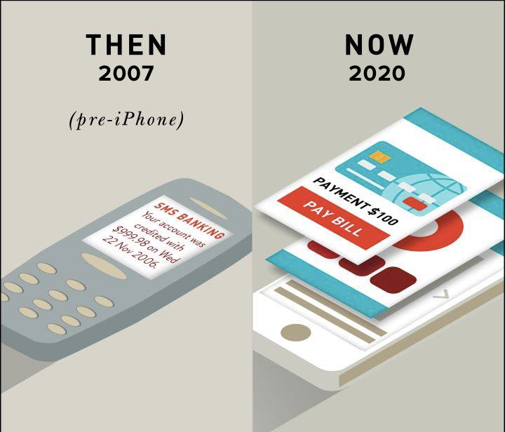
HOW:
How to find opportunities in change?
Leverage data
Industry advantage: data availability (unlike ecommerce, taxi,food)
Huge scope for multi-faceted digital transformation
Embrace change to turn wishlists into action plans
Leadership to push transformation

Slide 4
WHERE:
A playbook to thrive
Operational Excellence
New Normal Market Expectations
Ready to adapt
Ready to serve
Ready data foundation
New internal model
Agile operations
Better margins
New Value & Services
Customer Satisfaction
External transparency with tenants/occupants
Internal visibility
Proactive services

Slide 5
WAY FORWARD:
Properties are no longer only physical immovable assets but dynamic centers. And operations is becoming a fundamentally strategic arm of business.

Slide 6
Let’s champion change together.
Property Operations. Reimagined.
Notes:
Lets champion change together. Adapting to the the unknown together Let’s create opportunities in adversities.

