Slide 1
The Future of Quantity Surveying with Big Data

Slide 2
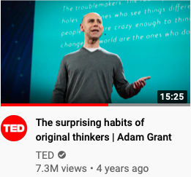

Slide 3
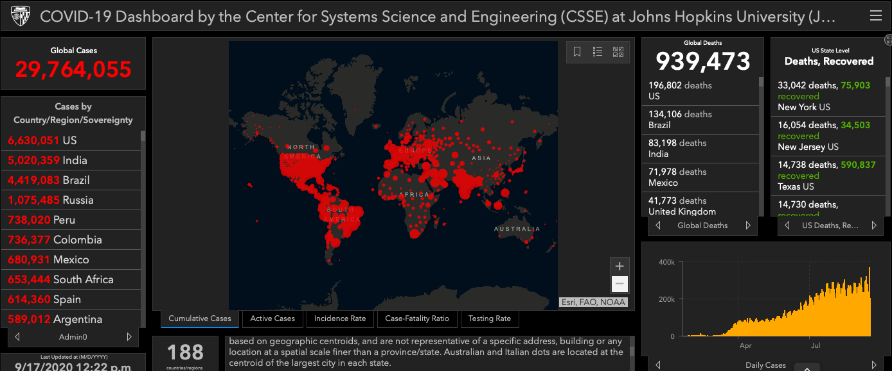
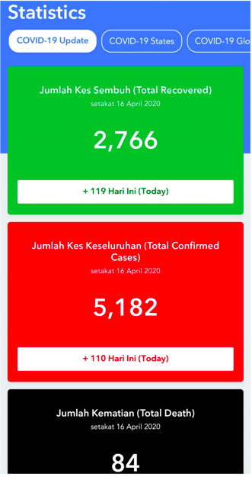
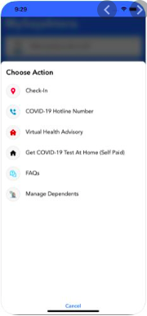
Big Data is Transforming Our Lives
Notes:
Tracking, screening for infection, contact tracing,

Slide 4
PHYTON
TRANSFORMATION

Slide 5
Clueless
74%
Interesting!
But what is big data?
Automation
8%
‘Press button and get analysis we desire’
3V Characteristics
17%
‘Data data here and there, data everywhere’’.
Data Maximization
<1%

Slide 6
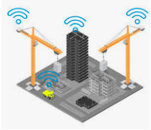
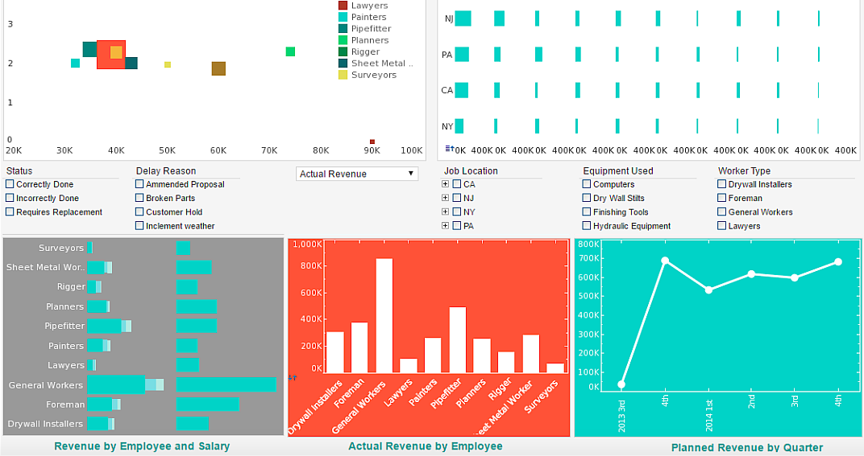
The Big Data Idea: Interconnection

Slide 7
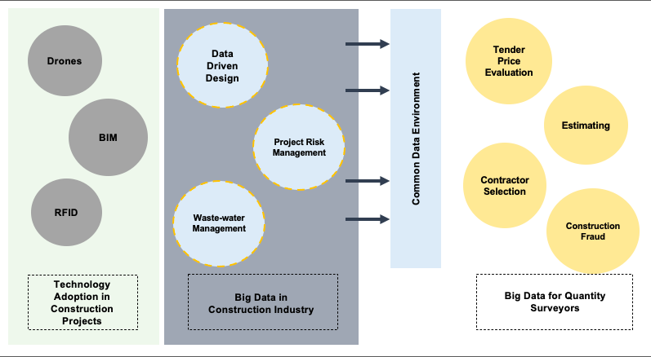
Why now is the best time for big data

Slide 8
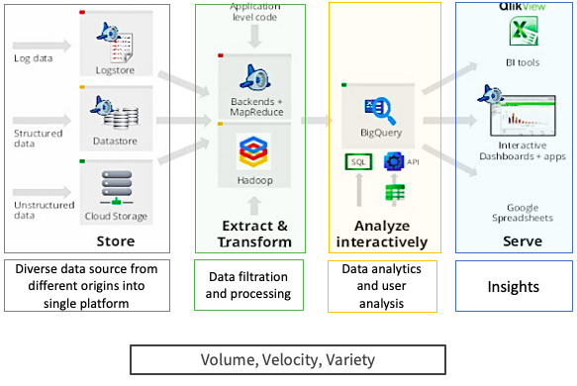
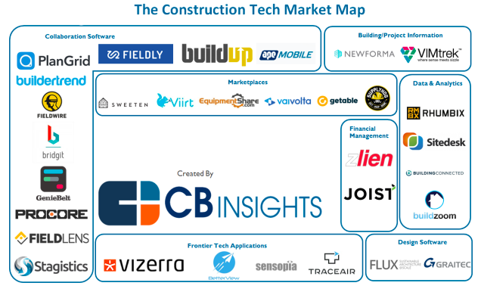
Big Data: An Integrated Technology
Common Data Environment
Project Management
BIM360
NoteVault
Aconex
CMiC
Primavera
PlanGrid
Estimating
Prequalification
Glodon
CostX
Accubig
CMiC
Procore
SmartBidNet
Notes:
Big data cannot stand-alone but it should exist as one

Slide 9
Big Data: Streamlining Construction Process
Pre-Contract
Post-Contract
Cost control: Estimation/ planning/ VE/ LCC
Contractual strategy
Tender evaluation
Pre-qualification
Contractor selection
Real time construction & documentation
Project planning & risk mitigation
Variation evaluation
Cash flow management

Slide 10
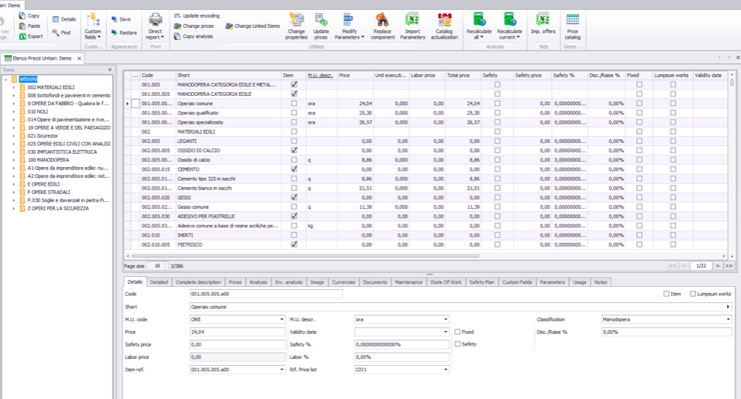
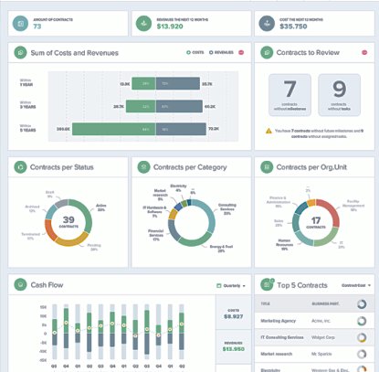
The Big Data Transformation
Cost and Revenue
Contractor Performance
Contracts
Contracts Category
Cost control/ estimation
Contractual strategy
Tender evaluation
Pre-qualification
Contractor selection
Cashflow Performance Review
Top 5 Contractor

Slide 11
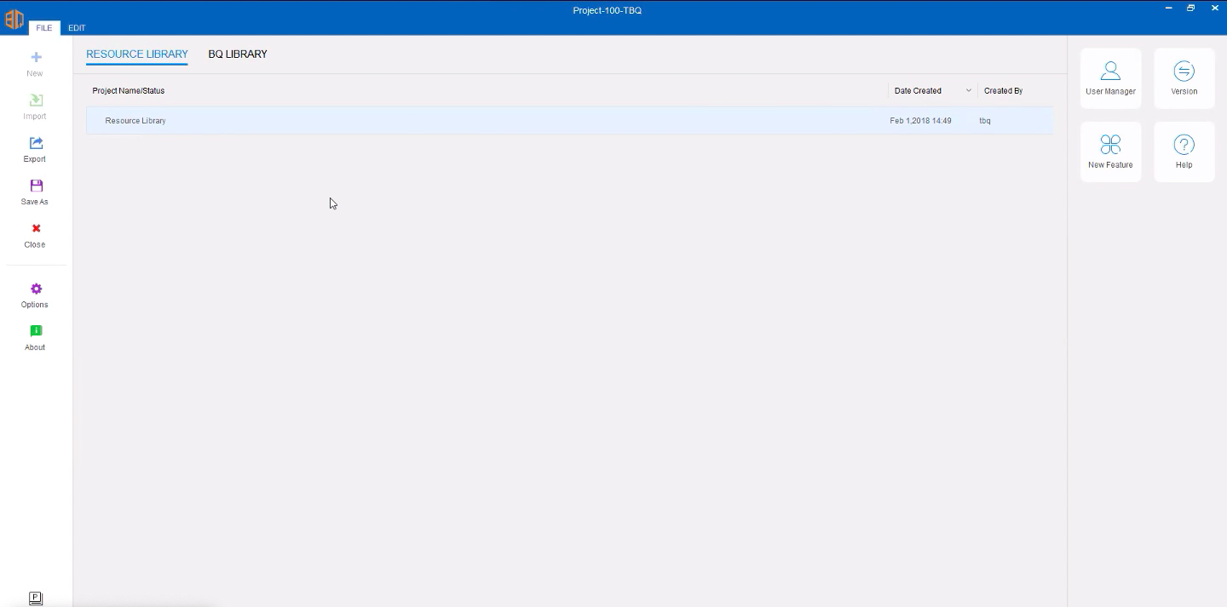
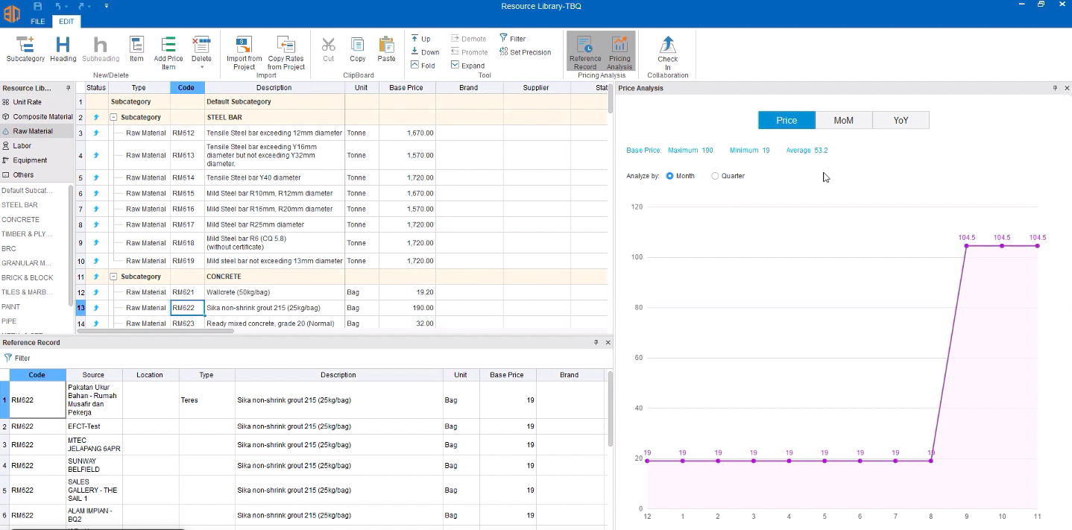
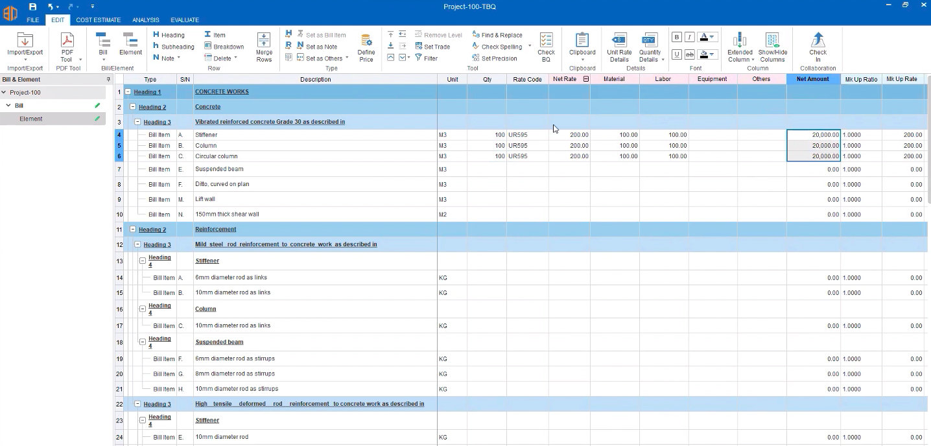
Notes:
Resource library

Slide 13
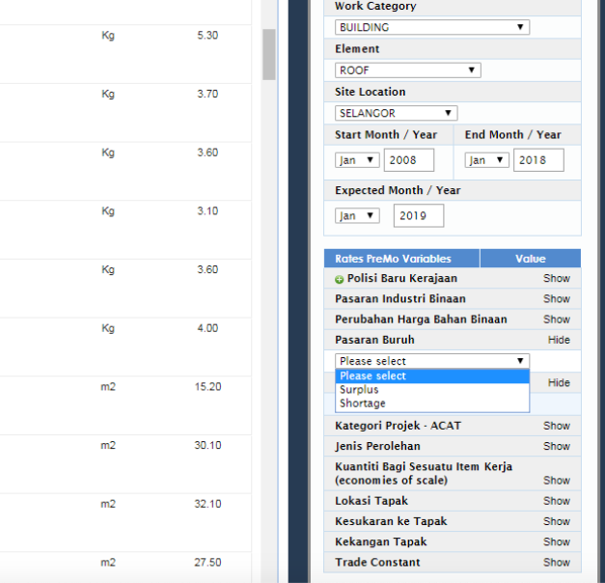
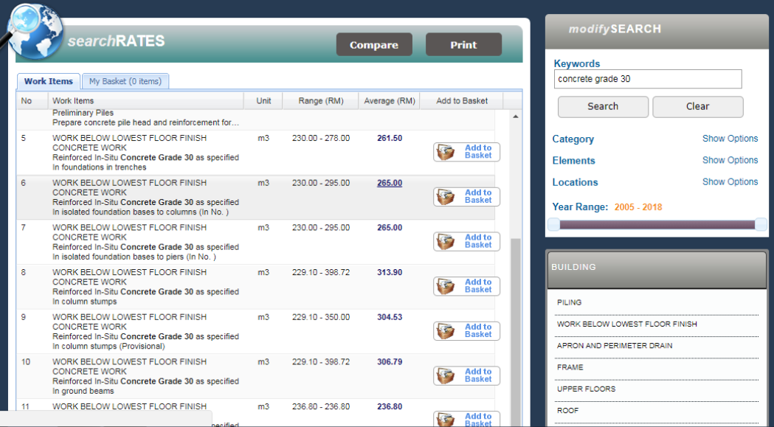

Slide 14
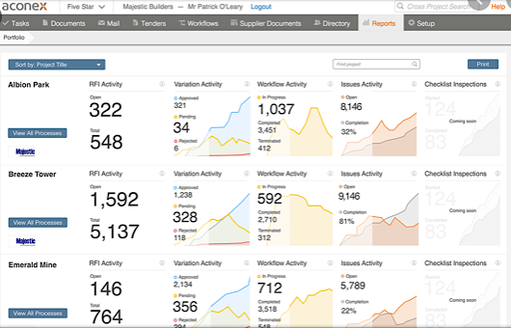
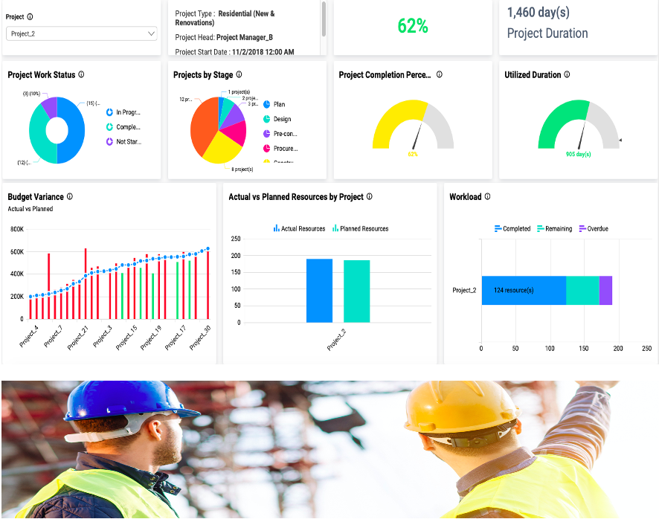
The Big Data Transformation
Activity
Variation
Workflow
Issues
Check
Real time construction & documentation
Project planning & risk mitigation
Safety planning & mitigation
Project Work Status
Projects by Stage
Project Completion
Utilized Duration
Budget Variance
Actual Vs Planned Resources
Workload

Slide 15
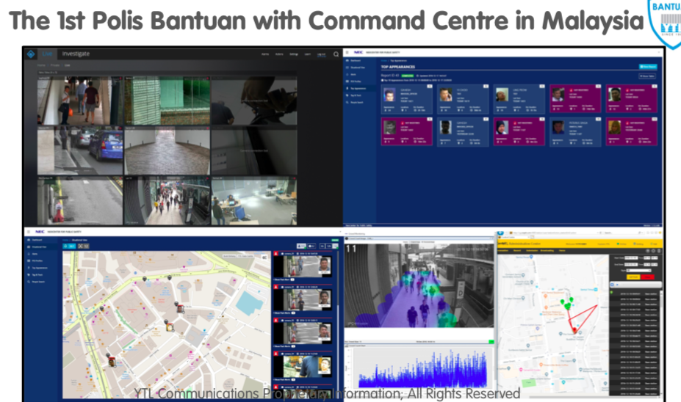
Revolutionizing New Business Model

Slide 16
Measurement
Current & Future Roles
Feasibility Study
Final Account
Risk Management & Analysis
Value Engineering
Value Management
Life Cycle Costing
Tendering Documentation
Past Roles
Data Management & Information Skills
Procurement, Law and Contract
Building Information Modelling & Mapping Measurement
Arbitration & Dispute Resolution
Dispute Management
Financial management of multiple project/supply chain
Construction Insurance, tax & insolvency management
Carbon Accounting

Slide 17
Big Data: Endless Possibility
Design optimization
Project costing
Investment risk assessment
Project planning & risk mitigation
Safety planning & mitigation
Facilities management
Energy management
Waste management
New business model

Slide 18
Think about what we can achieve if we empower our staff, giving then room to make
valuable decisions
instead of laying bricks
Think about what we can achieve if we empower our resources and start giving value to our customers

Slide 19
Zafira Nadia Maaz, PhD
Senior Lecturer of Quantity Surveying
zafiranadia@utm.my
+6012-7740020
Thank you
www.linkedin.com/in/zafiranadiamaaz
Faculty of Built Environment & Surveying, Universiti Teknologi Malaysia

