Slide 1
Gene Eidelman
Azure Printed Homes
Changing The Way Homes Are Made

Slide 2
The Problem
Construction’s environmental impact
The construction industry is generating an estimated 39% of the world's CO2 emissions.
Developing clear criteria
There is a lack of standard definitions and benchmarks for net zero in construction.
Sustainability compliance
There is a lack of visibility when monitoring sustainable practices within the supply chain.

Slide 3
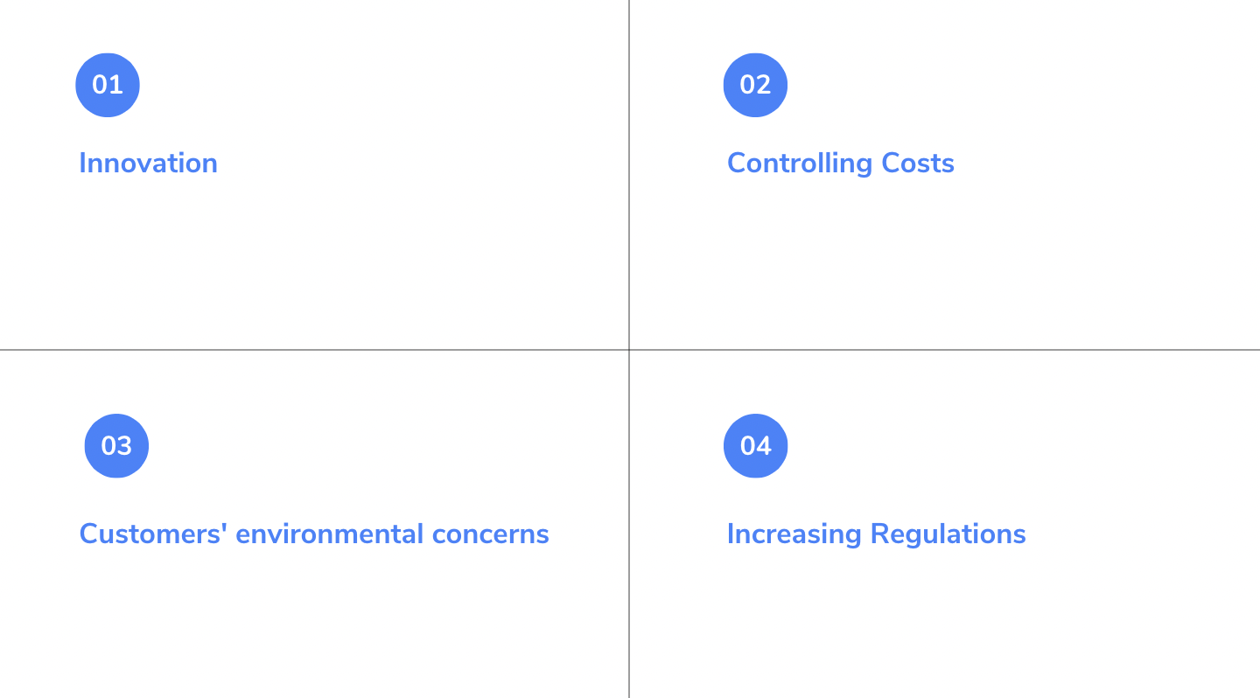
4 Factors Influencing Sustainable Change

Slide 4
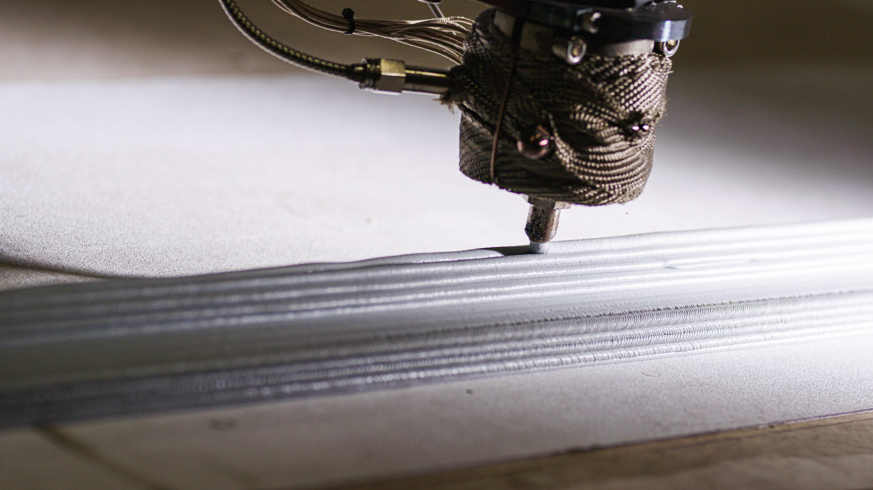
5 drivers of more sustainable construction
1) LEED certification
2) Factory-built
3) Site and Waste Management
4) Lean Construction
5) Innovation in Materials

Slide 5
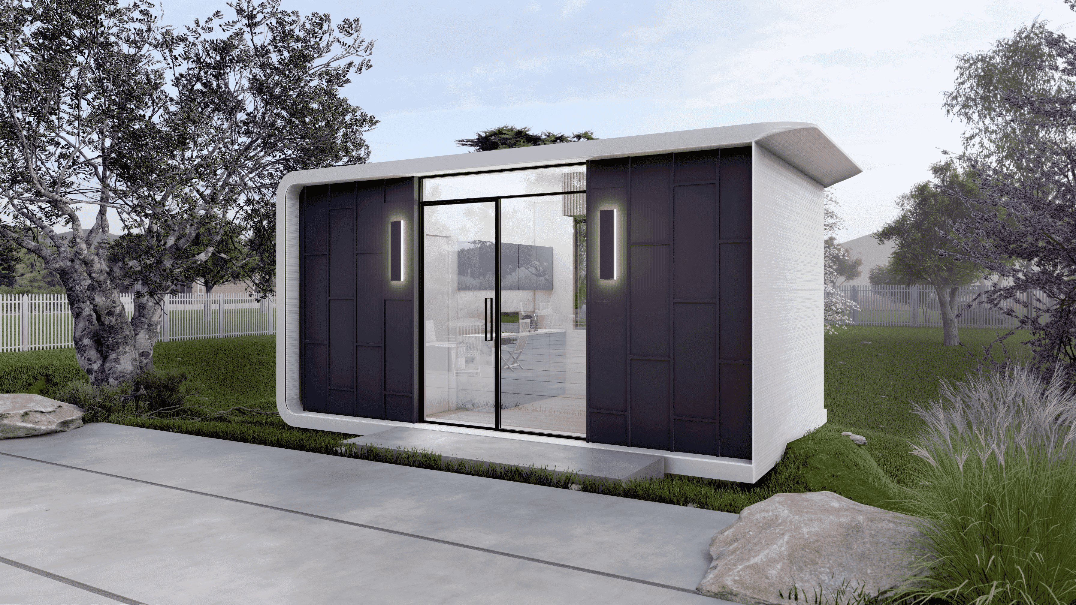
The construction industry can become more sustainable by creating a long-term strategy that considers sustainability in every process from start to finish.
A Sustainable Future is Good for Business And For Our Planet

Slide 6
CONTACT
Gene Eidelman
Azureprintedhomes.com
gene@azureprintedhomes.com

